Slide 1
SAS Tips & Techniques from around the Globe
Phil Mason

Slide 2
A little about me...
20 years using SAS
    Analysis & Programming, Design, Capacity Planning, Application Development, ...
Worked in Australia at:
    Coles Myer, ANZ, Telstra, NMHI
Worked in England & Belgium at:
    British Gas, Janssen Pharmaceuticals, Euroclear, Generale Bank, Sabena Airlines, Motorola, Oxfordshire Pharmaceutical Services, PPD (Pharms), Department of Work & Pensions, M&G (Financial Services), Office of National Statistics
Organisation of user groups
    Co-founded SMUG & VIEWS
    Organising committee of SUGI & SEUGI

Slide 3
How this course came about
Working at Telstra in ad hoc reporting
  time on my hands, read manuals
Posted daily tips to SAS-L for several years
Converted tips into a book via SAS B.B.U.
Ran course in UK with Tips Calendar authors
Expanded my 1/2 day to a full day
Ran in Belgium, Holland, Australia & USA

Slide 4
How this course has continued developing … over the years
I have given this course about 20 times, and each one is different
Keep adding material (just added this slide)
Material from new book
Material from SAS tips email list
Keep some old 6.12 material since people still don’t seem to know it (in my experience)
Add material from my other courses
  Advanced macro, advanced ODS/graphics, reporting, pharms, etc.
Updated with version 9 material

Slide 5
Base SAS
NESUG - September 2005

Slide 6
Data Step Tips

Slide 7
Create datasets which don’t show up in file listings
If you name a SAS dataset starting with “_to” or “_tf” then they will not appear in the following places:
  Proc Datasets
  Proc contents
  Libname window
  SAS Explorer window
Can be a useful technique to use if you want to create a “hidden” dataset
  beware as using Proc Datasets on one of these files can produce errors
  See TS note for more information … http://support.sas.com/techsup/unotes/SN/004/004367.html
data _top ;
set sashelp.class ;
run ;

Slide 8

New currency formats for UK and others
SAS 9.1.3 include new National Language formats, including a long awaited currency format for British Pounds.
  NLMNLAUD NLMNLCAD
  NLMNLCHF NLMNLCNY
  NLMNLDKK NLMNLEUR
  NLMNLGBP NLMNLHKD
  NLMNLILS NLMNLJPY
  NLMNLKRW NLMNLMYR
  NLMNLNOK NLMNLNZD
  NLMNLPLN NLMNLRUR
  NLMNLSEK NLMNLSGD
  NLMNLTWD NLMNLUSD
  NLMNLZAR

Slide 9
New IF functions
I found these by looking at “What’s New” doc
  IFN(condition, true-numeric-value, false-numeric-value, missing-numeric-value)
  IFC(condition, true-character-value, false-character-value, missing-character-value)
can be used anywhere a function can be used, even in where clauses or macro language (using %sysfunc)
Using them in macro language can eliminate need for macros at times

Slide 10
Ignoring case for comparisons
When comparing text in SAS you will note that uppercase and lowercase are not equivalent. So “abc” does not equal “ABC”. Sometimes you may want to compare text and ignore case. There are several ways to do this.
Method 1
If using a where clause you can use the upcase() function against any variables, and make sure that any text literals are in uppercase.
e.g.
  proc print data=mydata ;
  where upcase(name)='PHIL' ;
  run ;
Method 2
In a datastep convert all text to uppercase, so you will then compare uppercase with uppercase. You also need to make sure that any text in custom formats is also in uppercase. The following code demonstrates a simple but effective technique for creating an array containing all character variables and then processing them in some way. You can also use the VNAME() function to handle individual variables as exceptions.
e.g.
  data test ;
  set sashelp.prdsale ;
  * make an array containing all character variables currently defined ;
  array c(*) _character_ ;
  * loop through array ;
  do _i=1 to dim(c) ;
  vname=vname(c(_i)) ;
  * uppercase each character variable, except COUNTRY ;
  if vname^="COUNTRY" then
  c(_i)=upcase(c(_i)) ;
  end ;
  run ;

Slide 11
Reading more complex XML files
SAS 9 can read basic XML very easily using the XML engine
can also use XML maps to read more complex XML files
Reading hierarchical XML files that have many levels can be cumbersome (or almost impossible)
  If the number of levels can vary, this is impossible
Here is some code to process more complex XML files.

Slide 12
Basic XML
1 of 2
SAS 9 handles XML extremely well via the XML libname engine. To create an XML file I could use some code like this.
SAS Code to create XML
  libname test xml 'c:\test.xml' ;
  data test.sample ;
  name='Phil Mason' ;
  age=40 ;
  sex='M' ;
  phone='01491 824905' ;
  country='England' ;
  run ;
  libname test ;
XML created in c:\test.xml
  <?xml version="1.0" encoding="windows-1252" ?>
  <TABLE>
  <SAMPLE>
  <name> Phil Mason </name>
  <age> 40 </age>
  <sex> M </sex>
  <phone> 01491 824905 </phone>
  <country> England </country>
  </SAMPLE>
  </TABLE>

Slide 13
Basic XML
2 of 2
What happens if you write multiple datasets to an XML file?
The following code will only write the last file (test.c) to the XML.
libname test xml 'c:\test.xml' ;
data test.a ; x=1 ; run ;
data test.b ; x=1 ; run ;
data test.c ; x=1 ; run ;
libname test ;
This code will also only write the last file (test.c) to the XML, even though the log seems to indicate that they have all been written.
libname test xml 'c:\test.xml' ;
data test.a test.b test.c ; x=1 ; run ;
libname test ;
I could use the following code though, which would create an XML file containing all three tables.
libname test xml 'c:\test.xml' ;
data a b c ; x=1 ; run ;
proc copy in=work out=test ;
select a b c ;
run ;
libname test ;
SAS Code to use XML
To make use of the XML file produced above I could simply point my libname statement at it, and then refer to the table name defined in the XML.
libname test2 xml 'c:\test.xml' ;
proc print data=test2.sample ;
run ;
libname test2 ;

Slide 14
Adding a progress “bar” to a data step
If you have a long running data step then you may find yourself sitting there wondering if SAS is actually doing anything or not. One way to indicate what is happening is to display an indicator of progress to the user. The following macro will show the number of the record currently being read in. If you were to show this for every record it would slow down the data step while the display was updated, so you specify how often to update the display. Typically updating about every 1000 records will give a good indication without slowing things down.
The PROGRESS macro
  %macro progress(every) ;
  window progress irow=4 rows=7 columns=40
  #1 @6 'Processing record: ' _n_ persist=yes ;
  if mod(_n_,&every)=0 then
  display progress noinput ;
  %mend progress ;
How to use it
All you need to do is to add the macro call to your data step. The following data step updates the record count every 1000 records read in.
  data x ;
  infile 'm:\datasets\x.txt' ;
  input name $30. phone $18. ;
  %progress(1000) ;
  run ;

Slide 15
Locking files
Useful to restrict access to a dataset to one person
  Others can’t read or write a locked file
Doesn’t require SAS/Share
To lock a file use the LOCK statement …
  lock work.test ;
To clear a file …
  lock work.test clear ;

Slide 16
Referencing permanent datasets
Don’t need to use libref
Can use path to physical file
Proc print data='c:\test.sd7' ;
run ;

Slide 17
Compiled data steps
Code is now stored with compiled data step
  Use describe to see the code
    data pgm=x ;
    describe ;
    run;
  use execute to run the code again
    data pgm=x ;
    execute ;
    run;
  to run
    data pgm=x ; run ;

Slide 18
Logical library concatenation
In 6.12 you must specify each path in a concatenation
In 8 onwards you can specify librefs as well as paths in a concatenation
e.g.
libname x (sasuser sashelp) ;
libname sasuser ('c:\' sasuser) ;

Slide 19
Catalogs can be concatenated
Implicitly
  libname x (‘c:\’ ‘d:\’) ;
Explicitly
  catname x.a (sasuser.profile sashelp.fsp) ;

Slide 20
Generation data sets
keep multiple copies of data sets
  data x(genmax=5) ;
  run ;
Refer to a particular generation
  Either absolute or relative reference
  data y ;
  set x(gennum=25) ;
  set x(gennum=-2) ;
  run ;

Slide 21
Footnotes from a data step
By default TITLES are used from a data step in output
From SAS 8 onwards we can specify to use FOOTNOTES from data step, as well as titles
  file x footnotes ;

Slide 22
Integrity constraints
Define valid values for variables in datasets
4 types of ICs
  Check
  Not null
  Unique
  Primary key
3 referential actions for foreign keys
  Restrict
  Set null
  cascade

Slide 23
Integrity Constraints
proc datasets ;
modify people ;
ic create null_name=not null(name) ;
ic create check_sex=check(where=(sex in ('M','F')));
ic create one_ser=unique(serial) ;
ic create prim=primary key(serial) ;
modify classes ;
ic create null_class=not null(class) ;
ic create for_key=foreign key(serial)
references people
on delete set null
on update cascade ;
run ;
quit ;

Slide 24
Renaming variables
Dataset option rename=
  handles variable lists now
data x ;
array a(10) $ 2 ;
a1=1;
run ;
proc print
data=x(rename=(a1-a10=b1-b10)) ;
run ;

Slide 25
Compressed datasets
compress
  6+ … yes, no
  8, 9 … char, binary
point= & firstobs= now work on compressed datasets
  data x(compress=yes) ;
  …
  set x(firstobs=20 obs=200) ;

Slide 26
Audit trails
Start audit trail using proc datasets
  proc datasets library=MyLib;
  audit MyFile alter=MyPassword;
  initiate;
  run;

Slide 27
Filename with wildcards
filename supports wildcards
filename c_all ‘c:\*.txt’ ;
57 filename c 'c:\*.txt' ;
58 data test ;
59 infile c ;
60 input ;
61 run ;
NOTE: The infile C is:
File Name=c:\test.txt,
File List=c:\*.txt,RECFM=V,LRECL=256
NOTE: The infile C is:
File Name=c:\dumpconsole.txt,
File List=c:\*.txt,RECFM=V,LRECL=256
NOTE: 0 records were read from the infile C.
NOTE: 0 records were read from the infile C.
NOTE: The data set WORK.TEST has 0 observations and 0 variables.
NOTE: DATA statement used (Total process time):
real time 0.01 seconds
cpu time 0.01 seconds

Slide 28
Working with missing values
Missing value .
Special missing values .A, .B, .C, … .Z
Testing for a missing value of any type using MISSING()
missing(expression | variable);
  Returns true if the expression or variable is missing.
  e.g. if missing(startdat) then …

Slide 29
Some useful new formats
character formats handle strings <=32k
ddmmyyxw. OR mmddyyxw. OR yymmddxw.
  put date ddmmyyc5.;
  16:03
  put date ddmmyyd8.;
  16-03-02
  put date ddmmyyp10.;
  16.03.2002
  put date ddmmyyn8.;
  16032002

Slide 30
Scan function enhancements
Scan from the left
  e.g. get the 3rd word from the left
l=scan(y,3) ;
Scan from the right
  e.g. get the 2nd word from the right
r=scan(y,-2) ;

Slide 31
Justify text within a formatted field
Put supports alignment
  Justify name to the right of 80 character field
put name $80. -r ;
  Justify name to the left of 80 character field
put name $80. -l ;
  Center name within 80 character field
put name $80. -c ;

Slide 32
Variable naming conventions
mixed case, up to 32 long
  saved in mixed case
  reference is case insensitive
  spaces and special symbols allowed
    (depending on system option for naming)
  * You need to use this …. options validvarname=any ;
e.g. “Applied Statistician’s”N=1;

Slide 33
Use wildcards in variable lists
Colon as a variable modifier … var:
Benefits
  Saves typing
  Makes code generic
Restrictions
  Colon must be at the end
    Can’t be embedded … ab:c
  Can be used in most places

Slide 34
Proc Format
Allows overlapping ranges with the MULTILABEL option
  proc format ;
  value agegrp (multilabel)
  13-19 =‘Teens'
  20-<30 =’20 something‘
  30-high='over 30 years'
  13-40 =‘Youngsters'
  40-high=‘Over the hill';
  run;

Slide 35
Proc Format
Make your own date/time formats
  DATATYPE= DATE | TIME | DATETIME
  Use directives to construct a date/time
    May have a leading zero
proc format;
picture spc9date (default=11)
other='%0d %b %Y' (datatype=date);
run;

Slide 36
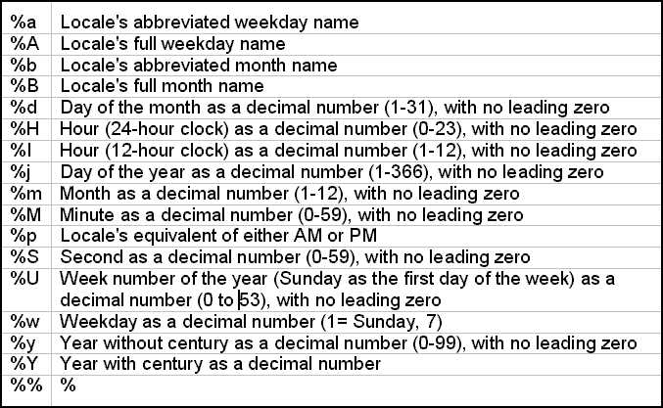
Proc Format - Directives

Slide 37
The constant function
The natural base 'E’
Euler constant 'EULER'
Pi 'PI'
Exact integer 'EXACTINT' <,nbytes>
The largest double-precision number 'BIG'
The log with respect to base of BIG 'LOGBIG' <,base>
The square root of BIG 'SQRTBIG'
The smallest double-precision number 'SMALL'
The log with respect to base of SMALL 'LOGSMALL' <,base>
The square root of SMALL 'SQRTSMALL'
Machine precision constant 'MACEPS'
The log with respect to base of MACEPS 'LOGMACEPS' <,base>
The square root of MACEPS 'SQRTMACEPS'

Slide 38
Proc Means
PRELOADFMT & COMPLETETYPES
  Summarises missing categories even when there are no input data
proc means data=data.efficacy completetypes;
types trtcd*sex;
class trtcd sex / preloadfmt;
var age ;
run;

Slide 39
Proc Means
Multi-Label Formats
  Allows overlapping ranges to be summarised
proc means data=derdata.efficacy;
class age / mlf order=fmt;
var baseline;
format age agefmt.;
run;

Slide 40
A view of a view is O.K.
Can define VIEWs of VIEWs
  Allows modifying SAS supplied VIEWS
    e.g. SASHELP.VMACRO
Can define recursive VIEWs
  Doesn’t detect recursive references
  Code can run forever
Total number of tables referenced cannot exceed 16 (sas 8, need to check sas 9)

Slide 41

Using GUIs in a non-GUI environment
WINDOW statement in data step
  Windowing and non-windowing platforms
  Displays text window, allows data entry
    When all fields filled an observation is written
    Entering blank fields ends data entry
  Doesn’t require SAS/AF, just BASE

Slide 42
Some useful return codes
&syserr … Procs, Data steps
  Re-assign before use in SYMGET()
&sysfilrc … Filename statements
&syslibrc … Libname statements
&sysrc … System commands
  Need XSYNC option set
Return code from Libname(), Filename(), System()

Slide 43
Some functions in SAS 6.12
ATTRC
ATTRN
CEXIST
CLOSE
CUROBS
DCLOSE
DINFO
DNUM
DOPEN
DOPTNAME
DOPTNUM
DREAD
DROPNOTE
DSNAME
EXIST
FAPPEND
FCLOSE
FCOL
FDELETE
FETCH
FETCHOBS
FEXIST
FGET
FILEEXIST
FILENAME
FILEREF
FINFO
FNOTE
FOPEN
FOPTNAME
FOPTNUM
FPOINT
FPOS
FPUT
FREAD
FREWIND
FRLEN
FSEP
FWRITE
GETOPTION
GETVARC
GETVARN
LIBNAME
LIBREF
MOPEN
NOTE
OPEN
PATHNAME
POINT
REWIND
RXCHANGE
RXFREE
RXMATCH
RXPARSE
RXSUBSTR
SET
SYSMSG
SYSRC
VARFMT
VARINFMT
VARLABEL
VARLEN
VARNAME
VARNUM
VARTYPE

Slide 44
New functions to SAS version 8
PUT
QUOTE
SCAN
COMB
CONSTANT
DEVIANCE
FACT
PERM
PROBBNRM
PROBMC
RXMATCH
RXPARSE
VARRAY
VARRAYX
VFORMAT
VFORMATD
VFORMATDX
VFORMATX
VFORMATN
VFORMATNX
VFORMATW
VFORMATWX
VINARRAY
VINARRAYX
VINFORMAT
VINFORMATX
VINFORMATD
VINFORMATDX
VINFORMATN
VINFORMATNX
VINFORMATW
VINFORMATWX
VLABEL
VLABELX
VLENGTH
VLENGTHX
VNAME
VNAMEX
VTYPE
VTYPEX
DATDIF
JULDATE7
YRDIF
IORCMSG
MISSING
HTMLDECODE
HTMLENCODE
URLDECODE
URLENCODE
CONVX
CONVXP
DUR
DURP
PVP
YIELDP

Slide 45
New functions in SAS version 9
ANYALNUM
ANYALPHA
ANYCNTRL
ANYDIGIT
ANYFIRST
ANYGRAPH
ANYLOWER
ANYNAME
ANYPRINT
ANYPUNCT
ANYSPACE
ANYUPPER
ANYXDIGIT
CAT
CATS
CATT
CATX
COMPARE
COMPGED
COMPLEV
COUNT
COUNTC
FIND
FINDC
LENGTHC
LENGTHM
LENGTHN
NLITERAL
NOTALNUM
NOTALPHA
NOTCNTRL
NOTDIGIT
NOTFIRST
NOTGRAPH
NOTLOWER
NOTNAME
NOTPRINT
NOTPUNCT
NOTSPACE
BETA
LOGBETA
IQR
LARGEST
MAD
MEDIAN
PCTL
SMALLEST
PRXMATCH
PRXPAREN
PRXPARSE
CEILZ
FLOORZ
INTZ
KCVT
MODZ
ROUNDE
ROUNDZ
VVALUE
VVALUEX

Slide 46
Editing external files in place
Useful for modifications to large external files
  flat files, VSAM, etc.
  Avoids limitations with char length of 200.
Two ways to do this:
  put _infile_ writes out data read in then overwrite parts you want to change.
  SHAREBUFFERS on INFILE statement
    FILE and INFILE statements share same buffer

Slide 47

How to read the next value of a variable
LAG() can be used to read previous values
To read next value of a variable
  Merge data set with itself
  Don’t use a BY statement
    Data test ;
    merge xxx
    xxx(firstobs=2
    rename=(var=next_var)
    keep=var) ;
    Run ;

Slide 48
Tricks with functions
Cube Root
  y = x**(1/3) ;
Factorial x
  fact = gamma(x + 1) ; * v6+ ;
  fact = fact(x) ; * v8+;
Value for π (pi)
  pi = arcos(-1) ; * v6+ ;
  Pi=constant(‘pi’) ; * v8+ ;
Week of year
  weekofyr = intck('week',
  intnx('year',date, 0),date) ;

Slide 49
Multiple delimiters
Can specify multiple delimiters on an INFILE statement
  Use the DELIMITER parameter
    filename x ‘c:\autoexec.bat’ ;
    data x ;
    length a b c $ 40 ;
    infile x dlm=’:,\ ‘ ;
    input a b c ;
    put a= b= c= ;
    run ;

Slide 50
Input using ??
Using the SAS format modifier ??
Suppress printing of error messages and input lines when invalid data values are read
Stops _ERROR_ from being set
Useful reading data of uncertain quality
Avoids crashing out with errors

Slide 51
Length statement
Length function returns 1 for a null string.
  LENGTH(‘’) is 1, not 0
  LENGTH(TRIM(‘’)) is also 1
  Length(compress(‘’)) is also 1
Cannot get 0 from a length() function call

Slide 52

Incrementing with date/time
Easy way to get last day of month
INTNX(interval,from,number)
If number is 0, then truncation happens

Slide 53
Reading CATALOG members
Allows SAS Catalog members to be read or written using a datastep.
Usage is like …
  FILENAME test CATALOG
  'mylib.mycat.mainmenu.scl' ;

Slide 54

Use current date/time in titles
Using &sysdate and &systime give the date/time the SAS session began!
Use %sysfunc() function
Add date() & time() functions
  Title "This report was run on %sysfunc(date(), date9.) at %sysfunc(time(), time.)” ;

Slide 55
Finding undocumented options
The following code shows all the undocumented options
    PROC OPTIONS INTERNAL;
    RUN; Code
Some options
  $logflush … closes LOG after each line is written
    Became the documented option Unbuflog in SAS 8
  columns=80
  Rows=24

Slide 56
Data Encryption
ENCRYPT= dataset option
Must specify read password (READ=)
Can see text from unencrypted file clearly
Text from encrypted files can’t be seen
Encrypt dataset
View unencrypted file
View encrypted file

Slide 57
Basic Data Encryption
Simple method of manually encrypting numbers
  Encode
    coded=bxor(value,key) ;
    Binary: Value=10101101 98989
    : Key=00111001 12345
    : Coded=10010100 111252
  Decode
    decoded=bxor(coded,key) ;
    Binary: Coded=10010100 111252
    : Key=00111001 12345
    : DeCoded=10101101 98989
  truncates to nearest 1, so convert money to units
  doesn’t work with negatives, so keep a flag for that

Slide 58
Where on Output dataset
Where clauses can be used for filtering data
Usually they are used with input data
They can be used with output data too
Keeping selected _type_ values

Slide 59
Setting the page number
Set page number to any number
Use “pageno” system option
Uses
  Producing several reports from one SAS session for different customers
  Reconstructing pages of a report
Can access current page & line numbers

Slide 60
Views can move pre-processing into procedures for efficiency
Inefficient
    Data test;
    set x ; flag=1 ; run;
    Proc freq data=test;table flag;run;
Efficient
    Data test / view=test;
    set x ; flag=1 ; run;
    Proc freq data=test;table flag;run;
Changing data step to a view causes less I/O to be done
  Since data is read once, IF condition applied and record fed into proc sort directly
Data read here
… and again here
Data read here,
in PROC

Slide 61
Data step views for parsing text files to extract info
Useful if you have regular flat file data you want to process with SAS
Just define a view
    Data monthly / view=monthly ;
    Infile ‘c:\monthly.txt’ ;
    Input name $30. Address $30. ;
    Run ;
Can use view as input to other data steps and procedures and data will always be fresh, e.g.
    Proc report data=monthly ; run ;

Slide 62
Finding unmatched quotes
Have you seen this before
  WARNING: The current word or quoted string has become more than 200 characters long. You may have unbalanced quotation marks.
Steps to find
    Highlight half the code
    Find “’” all … find ‘”’ all
    If odd number then missing quote is there
    Repeat
    Magic string to close quote
Using v8/9 (on platforms supporting this) uses automatic colour coding, which can help

Slide 63
The magic string
Sometimes SAS can get a little mixed up (or the programmer can)
Can be caused by
  Unclosed macro definition
  unclosed comments
  unfinished steps
  un-quited procs like SQL
*);*/;/*'*/ /*"*/; %MEND;run;quit;;;;;

Slide 64
Clever Commenting
Can define macro variables which contain comment symbols
  Enables comments in several places to be enabled or disabled from one place
  Useful for debugging since debugging code can be enabled or commented out easily
%let a=/;%let b=*;
&a&b
proc print data=x ;
run ;
*/;
data _null_ ;
run ;

Slide 65
Quotes in comments versus macro comments
  * Quotes are OK in normal comments ' ;
  data test ; run ;
  %* quotes are not OK in macro comments ' ;
  data test ; run ;
  /* quotes are OK in these comments */
  data test ; run ;

Slide 66
Rolling 45 days of data
Not very efficient to subset one large dataset
    Data month ; set big ; where date ge today()-45 ; run ;
Can keep versions of dataset, similar to GDGs in MVS
  Most recent version of AGE in dataset AGE, the next one in INV01, etc.
    proc datasets lib=monthly ; age inv01 inv02-inv45 ;
Can make a view
    Data d45/view=d45; set inv01 inv02 … inv44; run ;

Slide 67
PUT syntax examples 1/2
Put x y z ;
Put ‘hello’ ’09’x ;
Put 132*’_’ ;
Put #3 @44 cost ;
Put var 1-5 ;
Put cost dollar12.2 ;
Put (a b) (1. ‘,’ $3.) ;
Put _infile_ ;
Put _all_ ;
Put _ods_ ;
Put a b c @ ;
Put d e @@ ;

Slide 68
PUT syntax examples 2/2
Put @10 name ;
Put @pos name ;
Put @(3*pos) name ;
Put a +3 b ;
Put a +gap b ;
Put a +(2*gap) b ;
Put #2 text ;
Put #line text ;
Put #(line*3) text ;
Put line1 / line2 ;
Put @1 title overprint
@1 ‘________’ ;
Put _blankpage_ ;
Put _page_ ;
Put name= phone= ;
Put my_big_array(*) ;

Slide 69
Run cancel
Can be used to test syntax of code
  Doesn’t run code, just checks syntax
Macro variable allows turning it ON or OFF for all data/proc steps you choose
    %let can=cancel;
    * or set can to blank ;
    %let can=;
    Data x ;
    Run &can ;
    Proc print data=x ;
    run &can ;

Slide 70
Sum of
Specifying the following will calculate x1 minus x4
    X=sum(x1-x4)
Specifying the following will calculate the sum of x1, x2, x3 & x4
    X=sum(of x1-x4)
  If x2 does not exist it will produce a message saying it is uninitialised
To take all variables between x1 & x4, in the order variables are defined in the dataset
    y=sum(of x1--x4)

Slide 71
Useful BY examples
Data rep ;
set months ; * sorted as Jan, Feb, Mar, etc. ;
By month_name notsorted ;
Run ;
proc format;
value range 1-2='LOW' 3-4='MEDIUM' 5-6='HIGH';
run;
data newtest;
format score range.;
set test;
by groupformat score;
if first.score then
flag=‘1’ ;
run;

Slide 72
Commenting out code using %macro
Using /* to comment out code works well unless you have /* comments in the code you’re commenting out
A */ ends all previous /* comments, it does not stack them
  i.e. “/* /* /* */” is valid
If you have code with lots of comments, including /* */ ones, or even macro definitions you can easily comment it all out
  %macro junk ;
  %mend junk ;

Slide 73
Nobs available prior to set
The following will work since nobs is set before execution
  Data ; If 0 then do ;set x nobs=num_obs; call symput(‘obs’,nobs); end ; stop ; run ;
Another way to do it is, without reading any observations is
  Data _null_ ; dsid=open(‘myfile’) ; nobs=Attrn(dsid,’nobs’) ; call symput(‘nobs’,nobs); dsid=close(dsid) ;run ;
This technique can be used to check if a dataset has any observations and then either run a report or produce an error message

Slide 74
Logic variations between IF & WHERE
The IF statement converts character variables to numeric
  The WHERE statement does not
So “if zero” and “where zero” have different results
    data a ; zero='0' ; run ;
    data b ; set a ; if zero then output ; run ;
    data c ; set a ; where zero ; run ;
Dataset a has 1 obs, b has 0 obs & c has 1 obs

Slide 75
Using Progress Bars in Base SAS (1 of 2)
You can produce progress bars for use in Data Steps or Macros.
  Useful to let users know how a long macro is progressing
This example shows how to do so for a data step
  A similar technique can be used from macro language using the %WINDOW and %DISPLAY statements.
Key points
  Define a window shaped like a bar
  Redisplay it each time we have some progress
  Just change value and link to routine to update bar

Slide 76
Using Progress Bars in Base SAS (2 of 2)
Important Statements in Code
  “Window bar ” defines progress bar display window
    Specifies position on screen
    Variable & colour used to display progressing bar
  “display bar noinput” refreshes the bar display and requires no input from user to continue

Slide 77
Use of special missing values
Standard missing value is .
Special missing values are .A, .B, … .Z
Comparison operators treat missing values as negative infinity (-∞)
Many procedures ignore missing values or treat them separately
  e.g. Using proc summary without MISSING ignores all missing values, with MISSING produces a crossing for each different missing value type
Used to assign different types of missing data
  e.g. .a means missing from file A, .b missing from file B

Slide 78
Doing custom headers & footers
data _null_ ;
file print header=head linesleft=ll ;
set sashelp.class end=end ;
put @1 name @10 sex @15 age
@20 height @30 weight ;
if end or ll<4 then
link foot ;
return ;
head:
put 'This is my report'
#3 @1 'Name' @10 'Sex' @15 'Age'
@20 'Height' @30 'Weight' / ;
return ;
foot:
put @40 'Report produced by PPD' ;
if ^end then
put _page_ ;
return ;
run ;

Slide 79
How missing is handled in addition
Adding numbers with a missing one returns missing – using sum does not
    Data _null_ ;
    x=1+. ; put x= ;
    y=sum(1,.) ; put y= ; run;
Special missing values are changed into standard missing values with addition
    data _null_ ;
    x=1+. ; put x= ;
    y=1+.z ; put y= ; run ;

Slide 80
Proc Printto to redirect and process log
Can redirect procedure output or LOG to a catalog member or external file
Useful for saving log and then analysing it
    proc printto log=work.test.test.log ;
    run ;
    proc printto print='c:\print.lst' ;
    run ;
    proc print data=sasuser.houses;
    run ;
    proc printto print=print ;
    run ;

Slide 81
Positioning input using text
Useful to position input at specific text
e.g. to read usage stats from the SAS log
    Filename logfile ‘c:\logfile.txt’ ;
    Proc printto log=logfile ; run ;
    Proc printto log=log ; run ;
    Data _null_ ;
    infile logfile ;
    Input @’used’ cputime 6.2 ;
    Run ;

Slide 82
Splitting output into different datasets
ODS can save output to datasets
  Summary is the object to save
  Match_all creates a dataset for each BY group
  Dset_list is macro variable which holds dataset names created
  Stats is prefix to use for naming datasets
ods output summary(match_all=dset_list)=stats ;
proc means data=sashelp.prdsale ;
by country ;
var predict ;
run ;
ods output close ;
%put Datasets created: &dset_list;

Slide 83
Rearranging variables
RETAIN statement can be used
    Data details ;
    Retain name address phone ;
    set details ;
LENGTH statement can be used
    data details ;
    length name $ 20 address $ 30 phone $ 15 ;
    set details ;
SQL can be used
    Proc SQL ;
    create table details as
    select name, address, phone, * from details ;

Slide 84
List of supplied ODS styles
Look at RESULTS window
Right click on results
Select templates
Expand SASHELP.TMPLMST
Select styles

Slide 85
Selecting 10% of observations randomly
Using the RANUNI function gives a pseudo random selection, which is repeatable
Really random
    If ranuni(1)<.1 then output;
  since this should be true about 10% of the time.
To get a representative Sample, order the dataset in a suitable way, e.g.
    Proc sort ; by country state ; run ;
  Get total observations, divide by number you want and take every n^{th} observation
  e.g. 1000/50=20, every 20th observation

Slide 86
When is 3 * 1/3 not 1
Numbers within SAS are handled with floating point arithmetic
    data _null_ ;
    a=1/3 ;
    b=3*a ;
    c=1-b ;
    put b= c= ;
    Run ;
Produces
    B=1 C=5.551115E-17
Fails due to floating point arithmetic being inexact
Get around it by using round function, or FUZZ in PROC FORMAT

Slide 87
ATTRIB allows association and repetition
Can specify groups of variables in an ATTRIB statement
Can specify groups of variables multiple times
The last listed value for an option is applied
Easier way of handling lots of variables
Sample Code
BONUS Tip – hit F1 on attrib word

Slide 88
Write to the log in colour
Use ERROR, WARNING or NOTE to generate output in various colours
  The keywords must be in uppercase, or it wont work
Default colours produced, though these can be redefined
  ERROR: produces red output
  WARNING: produces green output
  NOTE: produces blue output
Specifying a dash in place of the colon causes the ERROR, WARNING or NOTE text to be blanked out
%put ERROR: This is an error ;
%put WARNING: This is a warning ;
%put NOTE: Take note ;
%put ERROR- This is an error ;
%put WARNING- This is a warning ;
%put NOTE- Take note ;

Slide 89
Deleting macros
Can delete macro variables to save memory
  Use %symdel to delete one or more macro variables from the global symbol table
  Call symdel() will do the same from a data step
The following data
step can be used to
delete all user
defined macros
data _temp ;
set sashelp.vmacro ;
where scope='GLOBAL' ;
run ;
data _null_ ;
set _temp ;
call symdel(name) ;
run ;

Slide 90
Procedure Tips

Slide 91
Putting multiple graphs & tables on an HTML page
Use new tagset called the HTML Panel tagset
  available in SAS 9.2, but can be downloaded at http://support.sas.com/rnd/base/topics/odsmarkup/htmlpanel.html,
Like normal HTML tagset except you can break your page up into rows and columns.
  Could have 2 graphs at the top, followed by a table, then perhaps 3 columns with graphs in each, etc.
Note: before you can use this tagset you need to download it and run the proc template code in SAS to define it.

Slide 92
Traffic lighting a table with hot & cold
Traffic lighting is a technique often applied to tables to indicate visually whether something is good (green), OK (amber) or bad (red).
Easily implemented in Proc Tabulate with ODS
Another way to indicate good/bad is to use a graduated shading from Blue (cold) to Red (hot)
Key is to use feature within Proc Tabulate allowing override of style attribute “background” using a format
  The number in each cell is then applied to this format to get the color to use for the background color.
  I also create a format which smoothly moves from blue to red. The result is impressive.

Slide 93
Discovering ODS events, to help make tagsets
PROC TEMPLATE can be used to create custom tagsets
  MARKUP destination can use your tagset to create the required output.
  This is a hugely powerful and flexible facility – but tricky
  One common question is “what events should I define in my tagset?”.
To discover events we can use the following…
  EVENT_MAP
  creates XML output that shows which events are being triggered and which variables are used by an event to send output from a SAS process to an output file
  When you run a SAS process with EVENT_MAP, ODS writes XML markup to an output file that shows all event names and variable names as tags. The output helps you to create your own tagsets.
SHORT_MAP
  creates a subset of the XML output that is created by EVENT_MAP. e.g.
Also check Style_Popup & Style_Display

Slide 94
Add news to your SAS log
“News” option used to add contents of text file at the start of each SAS log
  used for sending news and information to SAS users across a company
Specified in a configuration file or on the invocation command for starting SAS
To use it, add something like this to your sasv9.cfg file, typically located in ‘C:\Program Files\SAS\SAS 9.1\nls\en’:
-news ‘c:\news.txt’
Sample log when SAS begins:
    NOTE: Copyright (c) 2002-2003 by SAS Institute Inc., Cary, NC, USA.
    NOTE: SAS (r) 9.1 (TS1M3)
    Licensed to OFFICE FOR NATIONAL STATISTICS, Site 0084110017.
    NOTE: This session is executing on the XP_PRO platform.
    NOTE: SAS 9.1.3 Service Pack 2
    +--------------------------------------------------------------------+
    | Greetings from Wood Street Consultants. |
    | |
    | For SAS Help Phone: 01491-824905 |
    | Email: help@woodstreet.org.uk |
    | |
    | SAS Documentation: http://v9doc.sas.com/sasdoc/ |
    | |
    | Upcoming Training: http://www.sas.com/offices/europe/uk/education/ |
    +--------------------------------------------------------------------+
    | |
    | Tip of the week |
    | --------------- |
    | Instead of using code like this ... |
    | if x=1 then y=2 ; |
    | else y=3 ; |
    | You can now use code like this ... |
    | y=ifn(x=1,2,3) ; |
    +--------------------------------------------------------------------+
    NOTE: SAS initialization used:
    real time 1.20 seconds
    cpu time 0.96 seconds

Slide 95
Useful SAS 9 presentations
It can be hard to find useful material on SAS 9 if you want to make presentations
SAS ACT Users Group (Australia) found at http://sausag.sasusers.net/presentations.htm has some great material
  also has a short tips page at http://sausag.sasusers.net/tips.htm.
My favourite is a SAS 9 overview by Neil Doody (SAS Institute) called “Under the Covers of SAS 9.1”
  great overview of SAS 9 architecture and the various products within it.
Here are some of the other good ones there…
  SAS Integration Technologies
  Peculiar PROCS
  Using Fast Lookups, Hash Tables in SAS 9
  Text Mining: What's up .doc
  Customising and Extending Enterprise Guide
  ASP .NET and SAS
  SAS9 - First Impressions
  Enterprise Guide 3
  and about 20 more

Slide 96
Editing with Audit Trails
Some people do edits directly in spreadsheets or databases which have no audit trail
  Data can be moved from them into SAS
We can define an audit trail on any dataset
  We then use the VIEWTABLE window to make edits
  VIEWTABLE is opened in edit mode on the whole table, showing variable labels and in form view mode
the audit dataset is shown here
  We could even use it to make changes to another database
Output showing changes recorded in audit dataset
The SAS System 09:51 Wednesday, March 23, 2005 1
Obs ACTUAL PREDICT COUNTRY REGION DIVISION PRODTYPE PRODUCT QUARTER
1 $220.00 $585.00 CANADA EAST EDUCATION FURNITURE BED 1
2 $220.00 $585.00 CANADA WEST EDUCATION FURNITURE BED 1
3 $329.00 $312.00 CANADA EAST EDUCATION FURNITURE BED 2
4 $329.00 $312.00 CANADA NORTH EDUCATION FURNITURE BED 2
Obs YEAR MONTH _ATDATETIME_ _ATOBSNO_ _ATRETURNCODE_ _ATUSERID_ _ATOPCODE_ _ATMESSAGE_
1 1993 Jan 23MAR2005:09:53:24 1 . Philip Mason DR
2 1993 Jan 23MAR2005:09:53:24 1 . Philip Mason DW
3 1993 May 23MAR2005:09:53:30 5 . Philip Mason DR
4 1993 May 23MAR2005:09:53:30 5 . Philip Mason DW

Slide 97
Counting data multiple times using formats
option available in PROC FORMAT definition of multiple labels for the same value – multilabel
  A typical time you may want to do this is when your data can be categorised in different ways.
Only certain procs support multilabel formats
  Means, Summary & Tabulate
  On the class statement in the procedure you must specify the mlf option.

Slide 98
Viewing Tables with variable names, not labels
Many people make use of the viewtable command in SAS, which can be used in different ways, for example
  from the command line “viewtable sashelp.class”
  abbreviated from the command line “vt sashelp.class”
  from the explorer window by double clicking on a dataset, or view
  from the explorer window by right clicking on a dataset or view, and then selecting open
By default when you view the table, you will see variable labels over each column. I know that this annoys some people and they would like to have variable names appear by default, so here is how to do it.
  click on the explorer window to activate it – making the context sensitive menus appropriate for it
  Select tools/options/explorer
  double click on “table” (or “view”, depending which you are changing)
  double click on “&Open”
Now you can see the command that is issued when you double click on a table in the explorer window, it is probably “VIEWTABLE %8b.'%s'.DATA”
Now add the following optional parameter to the end of this command … “colheading=names”. This makes the command now “VIEWTABLE %8b.'%s'.DATA colheading=names”
Exit the dialog boxes via OK, and you are finished.
If you wanted to open the table in form view, rather than table view then you could also add this … “view=form”. As far as I know these options are not documented anywhere.
  Colheading can be either names or labels.
  View can be either form or table.

Slide 99
Mixed Numeric informats
Unquoted numerics treated as numbers
Quoted text treated as character
Useful if reading data which has mixed values, which need to be interpreted in different ways
    Proc format ;
    invalue mixed
    ‘LOW’ = -99
    1-10 = 1
    11-20 = 2
    ‘BIG’ = 99
    other = 0 ;
    Run ;

Slide 100
Multiple PROCs on a page
Proc output sometimes is very short
  Options FORMDLIM=‘character’
  Character to delimit page breaks
To stop getting new page after PROCs
  Set FORMDLIM option to space
To get a new page after each PROC
  Set FORMDLIM to null

Slide 101
Quick & Dirty CSV files¹⁴³
Use Proc Tabulate with FORMCHAR
    Commas use FORMCHAR=‘, ‘
    EBCDIC Tabs:- ‘0540404040404040404040’X
    ASCII Tabs:- ‘0920202020202020202020’X
doesn’t work well with multi-dim tables
Also use NOSEPS (horiz lines), NODATE (date), NONUMBER (page nums), LINESIZE=254 (wide page), PAGESIZE=32767 (long page)

Slide 102
Nicer Print with BY groups
Special print layout available in Proc Print
Use ID & BY statements
  Should have same variable names
  Also works if a subset is used

Slide 103
Use ATTRIB for common definitions
Proc print without any labels or variable names
  This doesn’t work, since you can’t label _all_
    label _all_='00'x;
  This does work, since syntax supports it
    attrib _all_ label='00'x;
ATTRIB is good for applying a definition to many variables
  Formats, Informats, Labels, Lengths

Slide 104
Multiple output statements with SUMMARY
Can have multiple Output statements on a single PROC SUMMARY
e.g.
  Leave off NWAY to produce all levels
  Write different levels to different datasets
  Write different stats to different datasets

Slide 105
CLASS vs. BY in Summary
CLASS - best if memory is sufficient
  small number of class variables
  small number of unique values
BY - best if many variables or if data already sorted
  May need PROC SORT before SUMMARY
  Often work where CLASS fails

Slide 106
Ways to tune a SORT
Usually don’t need order maintained
  proc sort data=data-set NOEQUALS ;
More sort work datasets
  Options sortwkno=6 ;
Use mass storage for sort work space
  Options sortdev=device-unit-name ;
Reduce observations sorted with WHERE
  proc sort data=xxx(where=(…)) ;

Slide 107
Ways to tune a SORT
Can use all available memory
  options sortsize=max ;
Use other forms of memory to sort
  Hiperspace, VIO, RAM disk
If data is grouped, but not sorted
  by var-list NOTSORTED ;
If external data is pre-sorted
  data_set(SORTEDBY=var_list) ;

Slide 108
Fuzzy formats
Save storage space & processing time in numeric user defined formats
  Specify FUZZ=0
  The default FUZZ value is 1E-12
    proc format ;
    value money (fuzz=0)
    1=’A’
    2=’B’
    other=’C’ ;
    run ;

Slide 109
Nesting formats within other formats
Can nest value formats to five levels
  Been around for a long time
    SAS 6.07+
  MVS - use (! & !)
  PC - use [ & ]
Useful to modify standard formats

Slide 110
Kilo/Mega format
Fit more data on page, graph, screen
What does the format do?
  Uses MULT option to scale
  Applies suffix to indicate size
  Uses ROUND option
    avoids doing rounding in a data step
    saves on data step coding
    retains the precision in the number
    can be used repeatedly in different programs

Slide 111
Examining macro options
To view the settings of all macro options
proc options group=macro ;
Run ;
SAS (r) Proprietary Software Release 8.2 TS2M0
NOCMDMAC Do not support command-style macros
NOIMPLMAC Do not allow statement-style macro calls
MACRO Allow use of SAS macro facility
MAUTOSOURCE Allow the macro autocall feature
MERROR Treat apparent undefined macro references as an error
NOMFILE Do not write MPRINT output to an external physical file
NOMLOGIC Do not trace macro execution
NOMPRINT Do not display SAS statements generated by macro execution
MRECALL Search autocall libraries for an undefined macro name each time the macro is
invoked
NOMSTORED Do not use stored compiled macros
MSYMTABMAX=4194304
Maximum amount of memory allocated for the macro table
MVARSIZE=4096 Maximum length of value of macro variable
SASMSTORE= Libref associated with SAS data library containing catalog of compiled stored
macros
SERROR Treat references to undefined macro variables as an error
NOSYMBOLGEN Do not write results of resolving macro variable references to SAS log

Slide 112
Ways to save disk space
Reducing space saves money
  Delete temporary datasets after use
  Keep= & drop= statements / dset options
  WHERE= dset option / statement
  _null_ dset name
  With RLS can only keep one copy of data
  Use views, not temporary dsets

Slide 113
Ways to save disk space
  Temporary datasets
    RAM disk (Win, Linux, UNIX, OS2), VIO (MVS & CMS), Hiperspace (MVS)
  Dset compression (COMPRESS=YES)
    Pre v8 is good on char, bigger with num
    V8+ can use BINARY for numbers
  Pipes to read compressed data
  SQL for merge, summary, sort etc.
    not procs and DATA steps with temp dsets
  Delete unused indexes

Slide 114
Ways to save disk space
  Store application code centrally
  Store numbers intelligently
    many digits as numeric, few digits as character
  Temp files on Tape, cartridge, Zip disk, etc.
  SQL passthru
    uses temp file space of the server SQL system
  Store short coded values in dataset
    Decode using a format
  Access data where it is using engines

Slide 115
Ways to save disk space
  3rd-normal form
  Store data in required order or define index
  Delete obs not needed when read in
  Use length to shorten chars & nums
    Be careful with nums as precision can suffer
  Set length of SAS dates to 4
  Only keep data in permanent libs if needed after program runs

Slide 116
Macro Tips

Slide 117
Building a library of useful macros
SAS programmers should collect useful macros to reuse & save time
You can find some of mine here http://www.woodstreet.org.uk/Macros
  Fmt - create a format based on a dataset
  Chmod – change permissions for UNIX files/directories when creating a new dataset
  Doc – strips out comments from SAS programs to create documentation – useful if you follow some coding guidelines
  Catscan – copies all text from a SAS catalog to an external file and then views it, so you can search for text
  Cliplog2dset – copies a section of SAS log and stores it in a dataset
  Copyfile – copies a SAS dataset from one place to another using operating system commands (which are usually more efficient)
  Vars_on_dset – returns a list of variables that exist on a dataset from a specified list – useful when you need to code a list of variables but sometimes they may not all be possible
  From & till – use to mark the start and end of a section of code – comment block is written indicating timings
  Start & finish – use to mark the start and end of a section of macro code so that the code generated by macros is written to an external file thus making debugging easier
  Label – returns the label of a variable, which could then be used in a title/footnote
  Progress & progress2 – implements a progress bar in a data step

Slide 118

Command Macros
Create new commands
Use macro logic in commands
Must turn CMDMAC option on
    options cmdmac ;
    %macro test / cmd ;
    dir sasuser ;
    build ;
    eis ;
    %mend test ;

Slide 119
All data step functions now in Macro Language
%SYSFUNC or %QSYSFUNC
  Calls data step function
  %Qsysfunc calls function & quotes result
Can also specify a format
Can even do file I/O in macro language

Slide 120
Creating macro variable from Data Set variables
Using %sysfunc you can do dataset I/O in the macro environment.
When getting a variable value from dataset it is assigned a macro variable
The Set() function therefore assigns all variables to macro variables
    %let dsid=%sysfunc(open(sasuser.houses,i)) ;
    %syscall set(dsid) ;
    %let rc=%sysfunc(fetch(&dsid)) ;
    %let rc=%sysfunc(close(&dsid)) ;
    %put _all_ ;

Slide 121
Counting words in an expression
Here is one of the best ways to count words in an expression
  Uses compbl to compress blanks so there is one between each word
  Uses compress to eliminate all other letters.
%let longword=this is a very very long word;
%let numword=%eval(%length(
%sysfunc(compbl(&longword)))-
%length(%sysfunc(compress(&longword)))+1);
%put >&numword<;

Slide 122
Adding operators or functions to macro language
“=:” exists in data step, but not macro language
  Create a macro which carries out required function and returns a result
    %macro eq(op1,op2) ;
    %if %substr(&op1,1,%length(&op2))=&op2 %then
    1 ;
    %else
    0 ;
    %mend eq ;
    …
    %if %eq(abcde,ac) %then
    %put yes 1 ;
    %else
    %put no 1 ;

Slide 123
& versus && versus &&&
In Base SAS
  &name refers to a macro variable called name
  &&name is scanned twice by macro processor
  &&&name is treated as &(&name) Code
If used in SCL – SAS/AF
  &name tries to substitute SCL variable name, if it exists
    If it does not exist, then it looks for a macro variable called name
  &&name is useful since it doesn’t try to substitute an SCL variable even if one exists of that name, but uses the macro variable
  &&&name works as in Base SAS

Slide 124
Putting hex values in macro variables
Hexadecimal and binary numbers cannot directly be assigned to macro variables
  For instance, the following code does not work.
      %let tab='09'x ;
      %put field1 &tab field2 ;
      field1 '09'x field2
  You can assign value in data step and macro variable
    Hexadecimal:
      data _null_ ;
      * Put a tab character into TAB ; call symput(‘tab’,’09’x) ; run ;
      %put tab=&tab ;
    Binary:
      data _null_ ;
      call symput(‘flag’,inputn(‘01001’,’binary.’)) ; run ;
      %put flag=&flag ;

Slide 125
Use macros in SCL & other sub-languages
Macros are useful when coding other sub-languages within SAS such as SCL, SQL,
  SCL, resolved at compile time
    e.g. Can set array dimensions and then change macro variable in one place when new dimensions are needed
        %let x=20 ;
        array lev(&x) lev1-lev&x ;
        array type(&x) type1-type&x ;
    e.g. Macro loops to generate similar code where different variable names are required.
        %macro loop(limit) ;
        %do i=1 %to &limit ;
        call notify(‘obj’||&i,’_hide_’) ;
        %end ;
        %mend loop ;
        * Hide 20 objects ;
        %loop(20)

Slide 126
Writing generated macro code for analysis
Causes code generated by macros to be written to an external file.
  File can’t be accessed until the SAS session has ended
Write code generated by macros to an external file
  OPTIONS RESERVEDB1 MPRINT ;
  FILENAME MPRINT 'c:\macro.sas' ;
In release 8 the option “reservedb1” has been renamed to “mfile”
Very useful for complex macros with many loops and multi-ampersands
You can then run the code generated through data step debugger

Slide 127
Date constants and calculations
Very useful to use date constants, particularly in conjunction with date functions
  E.g. '31oct1999'd
Macro language only interprets these as character strings
Can treat them as date constants in macro language by using %SYSFUNC, e.g.
Log
Useful for date based looping, counting units in time periods, etc.

Slide 128
Searching program editor or log for macro variables
If you simply enter &macname in the FIND box, it will resolve &macname before looking
To search for the unresolved reference search for:
    %nrstr(&macname)
  %nrstr(&macname) resolves to &macname.

Slide 129
Unexpected Macro Overflow Errors (1 of 2)
Sample code
    %if &endtime eq %then %do ;
    %let endtime=%sysfunc(datetime()) ;
    %end ;
Works OK if &endtime is empty, but does not when it is populated
Endtime is set to a 14 char string which is a date time stamp and is fully numeric, e.g.
    endtime = 36237362736787
Doing comparison with endtime populated seems to call %eval for comparison
  So SAS seems to treat this character value as a number

Slide 130
Unexpected macro overflow errors (2 of 2)
Since &endtime is so big, an error resulst
    ERROR: Overflow has occurred; evaluation is terminated.
    ERROR: The macro will stop executing.
The "fix" is to force all comparisons to be string based
    %if "&endtime " eq " " %then %do ;
    %maketime(endtime) ;
    %end ;

Slide 131
Macro variables resolved in several places
This may look like it would fail
  %let cmd=dir;
  dm '&cmd' ;
Why?
  Because macro variable is in single quotes
But, it works!
  Macro variable is sent to command line and resolved there

Slide 132
Creating macro variable from Data Set variables
Using %sysfunc you can do dataset I/O in the macro environment.
When getting a variable value from dataset it is assigned a macro variable
The Set() function therefore assigns all variables to macro variables
    %let dsid=%sysfunc(open(sasuser.houses,i)) ;
    %syscall set(dsid) ;
    %let rc=%sysfunc(fetch(&dsid)) ;
    %let rc=%sysfunc(close(&dsid)) ;
    %put _all_ ;
Code
Useful for storing macro parameters in datasets

Slide 133
Various uses of macros in SQL
  Storing variables in alphabetical order within a macro variable
  Generating similar but repeated SQL statements
    E.g. SQL to generate a list of variables based on some parameters
      Select %var(2,3) from big.dataset ;
  Macro variables for passing parameters between all kinds of SAS programs (Base, SCL, etc.)
    Use symget(), symput() functions, %let

Slide 134
Arithmetic calculations in macros
%EVAL is a bit stupid
  Numbers with dots are characters
  Treats all numbers as integers
%SYSEVALF is clever
  Knows what a number is
  Does it in Floating Point

Slide 135
Special values in macro variables
Use symput() to assign special values
  Hexadecimal:
        data _null_ ;
        call symput(‘tab’,’09’x) ;
        run ;
        %put tab=&tab ;
  Binary:
        data _null_ ;
        call symput(‘flag’,
        inputn(‘01001’, ’binary.’)) ;
        run ;
        %put flag=&flag ;

Slide 136
Making code restartable
Why?
  Robustness, saves reprocessing data
  Save datasets & macro variables
    %put _user_ to a dataset or file
    Copy sashelp.vmacro to a dataset, e.g.
      proc sql ;
      create table sasuser.macros as
      select name,value from
      sashelp.vmacro
      where scope='GLOBAL' ;

Slide 137
Unspecified macro parameters
Example
  Produces the following output
%macro sales(a,type=) / parmbuff ;
%put a=&a type=&type syspbuff=&syspbuff;
%mend sales ;
%sales(car,red green blue,type=10) ;
a=car type=10 syspbuff=(car,red green blue,type=10)

Slide 138
Adds another autocall macro library
%macro addlib(lib) ;
%let BEFORE=%sysfunc(compress(%sysfunc(getoption(sasautos)),())) ;
%put BEFORE===>&before ;
options sasautos=(&lib &before) ;
%put AFTER===>%sysfunc(getoption(sasautos)) ;
%mend addlib ;
%addlib("c:\temp")

Slide 139
Defining useful characters
Registered Trademark sign
  Can either press ALT 0174 or use byte(174)
Copyright sign
  Can either press ALT 0169 or use byte(169)
Note: If using ALT technique must use numeric keypad
%let tm=%sysfunc(byte(174)) ;
%let c=%sysfunc(byte(169)) ;

Slide 140
Resolving macro expressions at data step execution time
Why use resolve()?
  useful for passing macro values in to data step at data step execution time
  Accepts a wider range of arguments than symget
    Can resolve macro variables or macro programs
    Can resolve more than one macro variable at once
  Can return different values at each iteration of the data step
X=resolve(‘&name’) ;
Y=resolve(‘%get_name’) ;
Z=resolve(‘&first &last’) ;

Slide 141
SQL Tips

Slide 142
Ordering variables alphabetically
SQL can do it!
  Sort variable names alphabetically
  Access Dictionary.Columns
  Store in macro variable
Uses two useful features
  into :macrovar
  separated by “something”

Slide 143
Portable SQL views
Don’t have to specify libref on from clause when view & source data are in same lib.
Allows view to be moved to another library
create view emu.debbie as
select * from emu.employee;
or
create view emu.debbie as
select * from employee;

Slide 144
Values to use in place of missing values
SQL COALESCE function
Useful when doing JOINs
e.g.
  SELECT coalesce(x.var, y.var, ‘???’) as var
  FROM x LEFT JOIN y
  ON x.key=y.key ;

Slide 145

_method on SQL
Undocumented option
  PROC SQL _method ;
Describes what methods are used in SQL

Slide 146
Building selection lists
SQL can generate list of values
  These can be "plugged in" to a WHERE clause
  Can produce very long lists of values <=32k
Use INTO & SEPARATED BY
Use macro variable in
  IF/WHERE clause with IN operator
  Custom Format creation

Slide 147
More usage statistics for SQL
Use STIMER option to give stats for each SQL statement
  Otherwise only get stats for the entire procedure
      Proc sql stimer ;
      select … ;
      select … ;
      Quit ;

Slide 148
Limiting data processed by SQL
Limit output produced using OUTOBS=n
  Limits the number of rows processed as target of each SQL statement
Limit input used using INOBS=n
  Limits rows processed from any one source.
    Proc sql inobs=10 outobs=20 ;
    create table ….

Slide 149
Using WHERE clauses on SQL Views
If you apply a WHERE clause to an SQL View, use SQL to do it.
SQL is capable of passing a WHERE clause to an underlying SQL query
  other parts of the SAS system can’t
Log
Useful when handling the SASHELP views on DICTIONARY tables
  Saves a lot of time
Log

Slide 150
Undocumented options in PROC SQL (1 of 2)
_AGGR N0_AGGR
_ASGN NO_ASGN
_DFR NO_DFR
_EXPR NO_EXPR
_METHOD NO_METHOD
_PJD NO_PJD
_PLAN NO_PLAN
_RSLV NO_RSLV
_SQP NO_SQP
_SUBQ NO_SUBQ
_TRAN NO_TRAN
_TREE NO_TREE
_UTIL NO_UTIL
PRIVILEGES
PUBLIC
ROLLBACK
CHECK NOCHECK
CODEGEN NOCODEGEN
DOUBLE NODOUBLE
FLOW NOFLOWW
MISS NOMISS
NONE
TIN NOTIN
TRIM NOTRIM
VERBOSE NOVERBOSE
OPT1 NOOPT1
OPT2 NOOPT2
PROMPT NOPROMPT
SMALLINT
ASYNCHRONOUS
MAGIC= <number>

Slide 151
Undocumented options in PROC SQL (2 of 2)
711 proc sql _method _tree _util ;
712 create table x as select * from sasuser.houses ;
NOTE: SQL execution methods chosen are:
sqxcrta
sqxsrc
Tree as planned.
p=05EE0758,n=00000000,t= 8,tag=0001 /-SYM-V-(HOUSES.STYLE:1 flag=01)
p=05EE07A8,n=00000000,t=-99,tag=0001 /-OBJ----|
p=05EE0348,n=00000000,t= -8,tag=0001 | |--SYM-V-(HOUSES.SQFEET:2 flag=01)
p=05EE02F8,n=00000000,t= -8,tag=0001 | |--SYM-V-(HOUSES.BEDROOMS:3 flag=
01)
p=05EE02A8,n=00000000,t= -8,tag=0001 | |--SYM-V-(HOUSES.BATHS:4 flag=01)
p=05EE0258,n=00000000,t= 16,tag=0001 | |--SYM-V-(HOUSES.STREET:5 flag=01)
p=05EE0208,n=00000000,t= -8,tag=0001 | \-SYM-V-(HOUSES.PRICE:6 flag=01)
p=05EE06B8,n=05EF00B0,t= 0,tag=0001 /-SRC----|
p=05EE04D8,n=00000000,t= 0,tag=0001 | \-TABL[SASUSER].HOUSES opt=''
p=05EE07F8,n=05EF0238,t= 0,tag=0001 --SSEL---|
sqxdst: SQSTEP: stepid=1, stepscope=1, stepup=0.
sqxdst: Symbols available above, bufleng=56.
sqxdst: Name STYLE , solt=0 0 8 2, offset=0.
sqxdst: Name SQFEET , solt=0 0 8 1, offset=8.
sqxdst: Name BEDROOMS, solt=0 0 8 1, offset=16.
sqxdst: Name BATHS , solt=0 0 8 1, offset=24.
sqxdst: Name STREET , solt=0 0 16 2, offset=32.
sqxdst: Name PRICE , solt=0 0 8 1, offset=48.
NOTE: Table WORK.X created, with 15 rows and 6 columns.

Slide 152
Break the 16 table limit in SQL
PROC SQL limits the degree of complexity it will handle in nested queries
It will not work if the query after expanding all nested queries exceeds 16 ‘tables’, or 32 in version 8.
If you hit the limit, try to recode your query in a better way
A quick-fix is to replace several SQL views with datastep views
  SQL does not optimise datastep views so they are not part of the limit

Slide 153
Building long selection lists in SQL
Macro variables may be up to 32k long
Useful to store long text strings, such as variable lists
  e.g. Can make a list of employees in one dataset to select from another
  Code

Slide 154
Mixing data step & SQL code
You can have data step code in an SQL statement
    data out / view=out ;
    set sasuser.houses ;
    if style='CONDO' then
    put _all_ ;
    run ;
    proc sql ;
    create table more as select * from out where price >100000 ;
  This creates a dataset and writes some variable information to the log
Can similarly have SQL code within a data step, by using views

Slide 155
Set theory in SQL
Set operators are provided
  OUTER UNION, UNION, EXCEPT, INTERSECT {CORRESPONDING} {ALL}
Works with tables having different numbers of columns or different types
Examples
    Select * from a
    intersect
    select * from b ;
    Select * from a
    outer union corresponding
    Select * from b ;

Slide 156
Finding out about dictionary tables
All are described in:
DICTIONARY.DICTIONARIES
Proc sql ;
Select * from dictionary.dictionaries ;

Slide 157
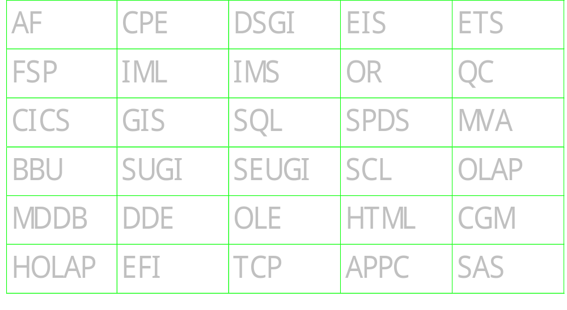
Acronym Quiz - how many do you know? (Old Quiz!)

Slide 158
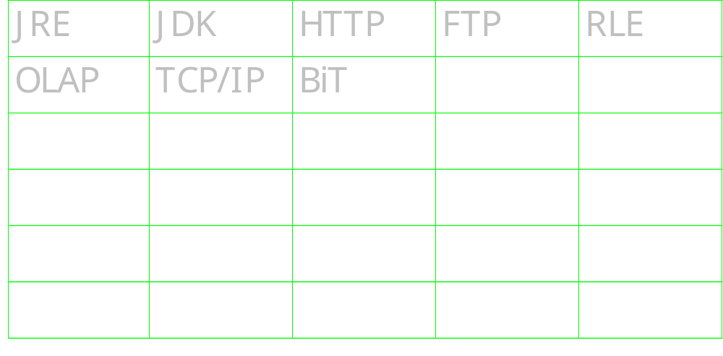
Acronym Quiz - how many do you know? (New Quiz, under construction!)

Slide 159
Windows specific
NESUG - September 2005

Slide 160
Create a pivot table from SAS
Considered solutions such as CSV, ODS with MSO XML directives, straight XML, DDE, and so on
  but these were all very complex
SAS program creates a spreadsheet
Visual Basic Script creates pivot table:
  open the spreadsheet
  add a new sheet for pivot table
  create a pivot table using wizard
  set the fields to be used in the table
SAS program could be extended to make a macro which creates the VBS file

Slide 161
Exporting data to Microsoft Access via XML
Need SAS/Access for PC File formats to move data
Can alternatively use XML engine on the libname statement
  Need xmltype=msaccess
    creates XML specifically for Access
  specify “xmlmeta=schemadata”
    get variables attributes included in the XML and imported by access too.
Finally you import the XML file from within Access by using “File”, “Get external data”.

Slide 162
Using the ZIP engine to read zip files
SASZIPAM
  Undocumented filename engine (SAS 9)
  Reads from compressed ZIP files directly
Refer to file within ZIP to read it
  For example
    ”tomcat.zip” contains a number of files
    to read “tomat.log” I specify “in(tomcat.log)”
      “in” is the libref
      “tomcat.log” is the file I will read from the zip file

Slide 163
SAS Performance Monitor
Uses Windows XP Performance Monitor
  SAS supports this by providing some SAS specific counters
  Logs can also be saved for later analysis
How to view SAS Performance data
  Start from “Control Panel”, “Administrative Tasks”, “Performance”
  Right click on graph and select “Add Counters”
  Under “Performance Object”, select SAS
  Check “All counters”, or select the ones you want
  Check “All instances”, or select the ones you want
  Click on Add, then click on Close
  Maximise the Performance window, so you can see things better.
  Now as you run SAS programs you will see the corresponding stats & graph

Slide 164
Connecting to ODBC the easy way
Need SAS/Access for ODBC
  Connects to many databases
  Use databases like they were SAS libraries
Define libref
  libname in odbc complete=" " ;
  %put Connection String: %superq(sysdbmsg) ;
  “Select Data Source” window pops up
  select, modify or define ODBC data sources
  you can pickup the connection string from macro variable &sysdbmsg
    That can then be put into the complete= string.
SAS Log
11 libname in odbc complete=XXX ;
NOTE: Libref IN was successfully assigned as follows:
Engine: ODBC
Physical Name: MS Access Database
12 %put Connection String: %superq(sysdbmsg) ;
Connection String: ODBC: DSN=MS Access Database;DBQ=D:\My Documents\db1.mdb;DefaultDir=D:\My
Documents;DriverId=25;FIL=MS Access;MaxBufferSize=2048;PageTimeout=5;

Slide 165
SAS vs. SPSS
There is a hard to find e-book about SPSS syntax
Has a chapter comparing the syntax of SPSS & SAS, that I have put here …
www.woodstreet.org.uk/files/SPSS%20for%20SAS%20Programmers.pdf
Here is an example of the material contained in it, which may be useful if you wish to make a case to SPSS users for moving to SAS
Reading Text Data
Figure 10-11
CSV text data file
ID,Name,Gender,Date Hired,Department
1,"Foster, Chantal",f,10/29/1998,1
2,"Healy, Jonathan",m,3/1/1992,3
3,"Walter, Wendy",f,1/23/1995,2
Figure 10-13
SAS code for reading CSV text data
data csvnew;
infile "c:\examples\data\csv_file.csv" DLM=',‘
Firstobs=2 DSD;
informat name $char15. gender $1. date_hired mmddyy10.;
input id name gender date_hired department;
run;
Figure 10-12
SPSS code for reading CSV text data
*delimited_csv.sps.
GET DATA /TYPE = TXT
/FILE = 'C:\examples\data\CSV_file.csv'
/DELIMITERS = ","
/QUALIFIER = '"'
/ARRANGEMENT = DELIMITED
/FIRSTCASE = 2
/VARIABLES = ID F3 Name A15 Gender A1
Date_Hired ADATE10 Department F1.

Slide 166
Capturing part of a SAS Log
Capturing the log is useful for doing further analysis, archive, etc.
Various ways to capture log
  Proc printto
  Copy & paste
The CLIPLOG macro
  This does a copy & paste, but using a macro to automate it
  Just copies desired part of log
Capturing part of a log
  Can use skeleton code to mark beginning of section to capture from
  ***BEGIN***; /* this marks where to start the copying from the log */
  /* now run all the SAS code you would like to capture */
  %cliplog(***BEGIN,***) ; /* finally we call the macro which captures the log from the point we previously marked */

Slide 167
Copy part of SAS log to a dataset, via clipboard
Use a series of Display Manager commands
  Highlights a section of the log between two “marks”
  Copies it to clipboard
Data step then reads clipboard
  Reading and writing to the clipboard is a new feature of SAS 9.

Slide 168
Getting the date, time & size of a non-SAS file
There are useful functions within SAS which can be used to tell you about SAS files (datasets, catalogs, etc.) but if you want information about other files then you may need to use other techniques. Here is one that is handy under windows and demonstrates some useful techniques.
  we generate a directory listing and read it via a pipe http://v8doc.sas.com/bin/ixcgisol/sashtml/win/zunnamed.htm
  we read the required information from that listing
  we write the information into macro variables, which are defined globally so they can be used throughout SAS http://v8doc.sas.com/bin/ixcgisol/sashtml/macro/z0206954.htm
  we make use of field justification to ensure that our comma formatted file size is left justified, rather than right http://v8doc.sas.com/sashtml/lgref/z0199354.htm

Slide 169
Exchanging data with Clipboard
Open a SAS notepad window, clear it, paste the contents of the clipboard into it and end
    dm 'notepad work.temp.temp.source;clear;paste;end';
Read the resulting file
    filename c catalog 'work.temp.temp.source';
    data _null_; infile c; input; put _infile_;
    run;
Can be done to write data to clipboard too
    filename c catalog 'work.temp.temp.source';
    data _null_; file c; put 'hello'; run;
    dm 'notepad work.temp.temp.source;curpos 1 1;mark;curpos max max;store;end';

Slide 170
Re-registering SAS filetypes
Sometimes you will install software which steals extensions used by SAS
Re-assign the extensions using the SAS setup program
  setup register
Invokes SAS System Setup to refresh Windows registry with default actions for SAS files.

Slide 171
Native question window
Give apps native look & feel
1st, Define module interface definitions
2nd, Call the DLL, ensuring you define a FILEREF for the definition file.
Module works on supported
operating systems – Windows, UNIX
Notes:
routine MessageBoxA module=USER32 minarg=4 maxarg=4
stackpop=called returns=short;
arg 1 input format=pib4. byvalue;
arg 2 input format=$cstr200.;
arg 3 input format=$cstr200.;
arg 4 input format=pib4. byvalue;
filename sascbtbl 'C:\sas\sascbtl.txt';
data _null_;
length hwnd style 8
text title $200;
text="This is message text, which should ask a question?";
hwnd=0;
Title ='This is a title';
style=32+4;
rc=modulen('*e', "MessageBoxA", hwnd, Text, Title, Style) ;
put rc=;
run ;

Slide 172
Module Definitions (partial list) sampsrc.pcsamp.sascbtbl.source
ExitWindows
GetDiskFreeSpaceA
GetDriveTypeA
GetModuleFileNameA
GetModuleHandleA
GetPrivateProfileIntA
GetPrivateProfileStringA
GetProfileIntA
GetProfileStringA
GetSystemDirectoryA
GetSystemMetrics
GetTempPathA
GetTempFileNameA
GetVersion
GetVersionExA
GetVolumeInformationA
GetWindowsDirectoryA
GetSystemInfo
MessageBeep
MessageBoxA
SwapMouseButton
WritePrivateProfileStringA
WriteProfileStringA
GetWin32sInfo

Slide 173
DOS commands without DOS box
You can use unnamed pipes to execute system commands.
    FILENAME 'run' PIPE ‘dir /w/s';
    DATA _NULL_;
    LENGTH line $ 80;
    INFILE run LENGTH=len;
    INPUT @;
    INPUT line $varying. len;
    PUT line;
    RUN;
  On some operating systems this does not give the DOS box at all.
Another way is to use module calls, e.g.
    Rc=modulen(‘*e’,’CopyFileA’,’c:\test.sas’,’c:\new.sas’,0) ;

Slide 174
Some useful code generators sometimes overlooked
Start with the generator to give basic code, then expand it
  Dexport/Dimport – export/import wizards
    For transferring data between SAS & EXCEL, etc.
  EFI – External File Interface
    Defines custom file layouts to import/export
  Query – SQL Query generator
  Proc report
  Sas/assist

Slide 175
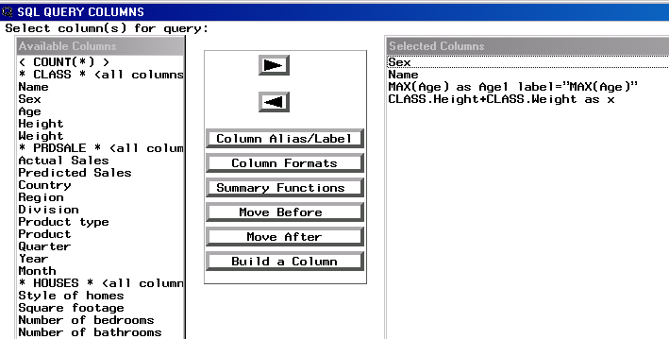
Query Window
Enter QUERY on the command line or select Tools-Query
  Select datasets you want, then OK
  Build query using GUI and Pmenus

Slide 176
Easy way to Exchange SAS data with other applications
STAT/Transfer
  Utility to transfer between database formats including SAS & many others
  E.g. MS Access, EXCEL, Dbase, Paradox, etc.
STAT/Engines
  Read/Write many PC formats directly
    Access Excel Lotus 123
    SPSS Dbase Quattro Pro
    Gauss Stata Paradox
    FoxPro S-Plus Sysstat
    demo
Also DBMS/Copy & DBMS/Engines
e.g.
  libname test STATTRAN ‘C:\test.wks’ ;

Slide 177
Email
Can easily send email from a datastep and attach external files.
  Useful in automating sending of reports/messages
Sample code
    filename mail email ' '
    to=(“philipmason@email.com")
    subject="&sysdate spreadsheet"
    attach ='c:\test.xls';
    data _null_;
    file mail;
    put "here is your spreadsheet";
    put " ";
    run;

Slide 178
Emits
Electronic Mail Interface to Technical Support
Best way to report problems to technical support
      To: support@sas.com
      From: philipmason@email.com
      Subject: big problem
      site=1234567890
      company=Wood Street Consulting
      phone=(01491) 824905
      area=install/unix
      release=8.2
      os=Win2000
      I am having big problems getting win2k to work with SAS. Please help. Log attached.

Slide 179
Running VB macros in EXCEL from SAS
Using DDE, you can send Excel 4.0 individual macro commands from SAS to EXCEL
  Can send an Excel 4.0 macro that will execute a saved Excel VB macro using DDE
      filename excdata dde 'Excel|System';
      data _null_;
      file excdata;
      put ' RUN("File.xls!Macro2",FALSE)]';
      run;
    where File.xls is the name of the Excel file where the macro is stored and Macro2 is the name of the Macro.
    These names are case-sensitive.

Slide 180
Date & Time from directories
SAS can read information from directories using functions (Dread, Dopen, etc.)
Can’t read date/time though
Following code uses a pipe to get dates/times
Code

Slide 181
SAS OLE Automation Server
How do I run demos from PowerPoint?
  PowerPoint has no scripting but can run programs
SASOACT.EXE
  Controls a SAS OLE Automation Server
    SASOACT.EXE action=Open datatype=SASFile filename=”Test.sas"
    SASOACT.EXE action=Submit datatype=SASFile filename=”Test.sas"
    SASOACT.EXE action=Open datatype=Data filename="Houses.sd2"

Slide 182
Passing parameters
There are various ways of passing parameters into SAS
  At invocation
  Autoexec.sas
  Config.sas
Using parameters passed in
sas.exe –sysparm=‘this & that’
Options Sysparm=‘data I want to pass in’ ;
-sysparm ‘Phil’
data _null_ ;
parm="&sysparm" ;
put parm= ;
run ;
%put This was passed in --->&sysparm<---;

Slide 183
Splash option
Can customise startup or even prevent a user knowing they are even using SAS
Do not display a logo when starting SAS
  c:\sas\sas.exe -nosplash
Display your own bitmap image when starting SAS
  c:\sas\sas.exe
  -splashloc c:\windows\setup.bmp

Slide 184
Viewing log while SAS is running
Can do it when running interactively
Can’t do it in batch (usually)
To view log in batch…
  SAS -$logflush
  Causes SAS to write the log one line at a time
  May slow down SAS a little

Slide 185
PC Spawner
Start PC Spawner from !sasroot on server
  !sasroot\connect\sasexe\spawner -netname sas_host
  -comamid tcp
Then signon from Client:
  options comamid=tcp
  remote=sas_host ;
  signon noscript ;

Slide 186
Improve Windows performance
Turn off unused services saves memory
  Settings, Control Panel, Services
    Select service, select stop - but be careful!!!
Some non-crucial services:
    Network DDE and Network DDE DSDM 1.6MB
    Spooler 1.3MB
    Clipbook Server 1.3MB
    Schedule 1.2MB
    Telephony Server 200KB
    Messenger 49KB

Slide 187
Default actions in Windows
SAS FileTypes have default actions
  Double-clicking SAS Dataset opens SAS & it
Change default actions to use SAS System Viewer
  free from the SAS Web site or SAS CD
Alter actions in Windows Explorer
  Use View, Options

Slide 188
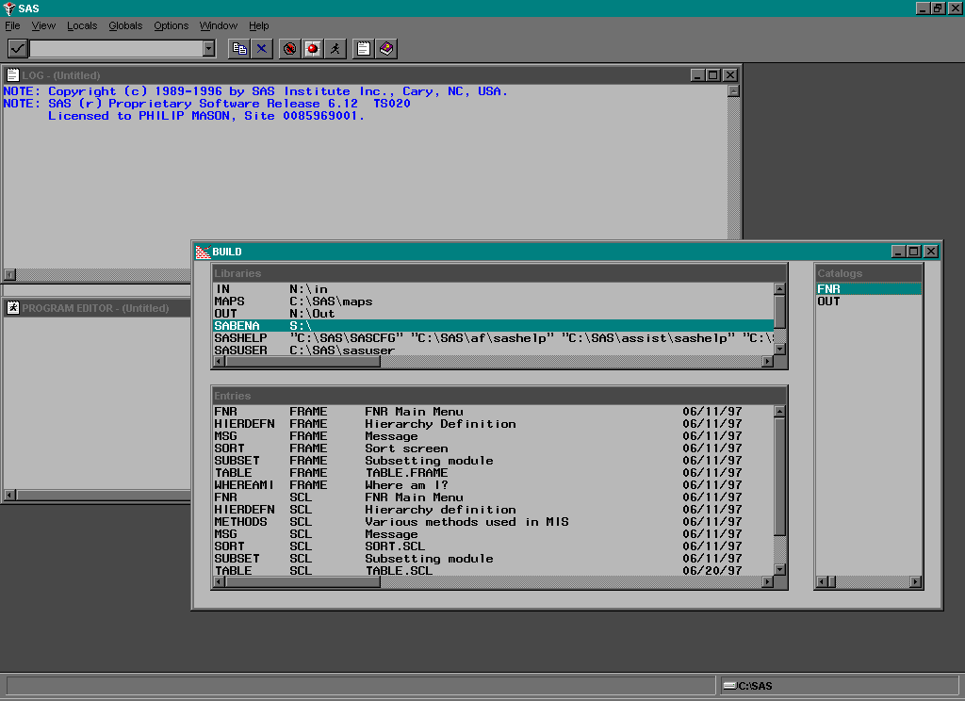
Capturing Screens Under SAS in Windows
Use Alt PrintScrn to snapshot current screen
Use Paste to put it into other applications:
  MS Word, Powerpoint, etc.
If popmenu is on screen then Alt Print Scrn doesn’t work
  but PrintScrn Alt does!

Slide 189
Using Abbreviations
Define abbreviation which upon pressing TAB will become the longer text
  For example, you could define the abbreviation myv6sasfiles, which would expand to 'c:\winnt\profiles\myid\personal\mysasfiles\v6';
  Abbreviations are actually macros that insert one or more lines of text.
Be careful not to use names for keyboard macros which are part of SAS reserved words
  For example, using name will cause problems with libname

Slide 190
Put a zip in your pipe
Pipes read live output from programs
filename testpipe pipe 'pkunzip.exe c:\temp\test -c’ ;
  Use PKZIP to decompress archive
  -c option sends data to console, flowing into pipe, able to be read by SAS
  PIPE parameter is required
Allows processing files too large for disk
Notes:
sbar:
call notify( 'sbar', '_set_cursor_shape_', sbar ) ;
text=sbar ;
return;

Slide 191
Reading directories
You can use the PIPE filename option:
    filename files pipe ‘dir /l/b c:\*.*’ ;
    data figfile ;
    infile files pad lrecl=128 ;
    input fname $128. ;
    run ;

Slide 192

Delete using O/S commands
Various ways to delete
  Tested delete of 100 datasets
Proc Datasets
  13 seconds
Proc SQL
  20 seconds
x ‘delete *.sd2’
  1.8 seconds

Slide 193
Nice DOS commands
Using X or system() means you can only get a return code from commands
Unnamed pipes can execute system commands & capture output
e.g.
Redirect STDERR to STDOUT
  filename x pipe ‘command 2>&1’ ;

Slide 194
Use TERMSTR to share files
The following option is new in the FILE, FILENAME, and INFILE statements:
  TERMSTR= enables the sharing of UNIX and PC formatted files.
  NL=Newline
  CRLF=Carriage Return, Line Feed
Make a UNIX formatted file, e.g.
  Filename x "c:\test.txt" TERMSTR=NL ;
Make a PC formatted file, e.g.
  Filename x "c:\test.txt" TERMSTR=CRLF ;

Slide 195
Set location to save autosave files
Specify location of Program Editor autosave file by using the AUTOSAVELOC system option
Specify in config file, autoexec file, invocation or via an options statement, e.g.
options autosaveloc=‘c:\’ ;

Slide 196
Miscellaneous
NESUG - September 2005

Slide 197
Latest tips from SAS UK
SAS UK have a newsletter they publish every 2 months which contains some SAS Tips. You can subscribe to the newsletter and browse past issues here http://www.sas.com/offices/europe/uk/newsletter/subscription/index.html
Following are some of the tips from the last five newsletters.
A Technical Look at What's New in SAS®9
There are several enhancements to the Macro Language Facility in SAS®9 including a new automatic macro variable, new comparison operators, new SAS system options, new macro statements, new functions, and a new option for the %MACRO statement.
Is There a Way to Reduce the Processing Time for Frequently Reused Data Sets?
Do you use a SAS data set multiple times within a program? Find out how to open and close the dataset only once.
How Can I Traffic Light My SAS Output?
Find out how to selectively colour cells in your tables based on specific data values.
How Can I Install SAS 9.1 in the Same Way as I Have Installed Previous Releases of SAS?
SAS 9.1 Foundation used to be called The SAS System for Windows. Here is a quick installation guide for SAS 9.1 Foundation on the Windows platform.
How Can I Use SAS to Compare Demographic Profiles?
(Written by Eli Y. Kling, GeoBusiness Solutions Ltd)
How do demographers use SAS to compare a profile of a subset population to the entire population profile? Here is an example comparing the car ownership profile of inhabitants of a certain city to the national car ownership distribution.

Slide 198
more
A Technical Look at What's New in SAS®9 - Base SAS Language
New and enhanced features in Base SAS save you time, effort, and system resources by providing faster processing and easier data access and management, more robust analysis, and improved data presentation.
In SAS®9, Saying "less" on the Command Line Provides Even "more"
(Written by Peter Crawford, Crawford Software Consultancy Limited)
Find out how SAS®9 uses multiple configuration files to make the most of running SAS in a mixed or multi-use environment.
How Do I Get a Pound (£) Symbol in my SAS Output Within SAS® 8 and SAS®9?
Although SAS does not have a standard pound format, there are a number of different ways to get the pound (£) symbol in your SAS output depending on the version of SAS you are running.
Did You Know that You Can Now Access PC Files on a Windows Machine Directly from a Unix Machine?
The new PC File Server with SAS®9, when combined with an installation of SAS/ACCESS® for PC Files Software on UNIX, enables you to access PC data from a UNIX machine. The server is a multi-threaded server with configurable user controls.
Did You Know that the Shortcut Key Ctrl + ] Searches for a Matching Bracket in your Code?
(Suggested by Andy Cooper, Direct Line Group Limited)
There are a host of shortcut keys that can be used to make your life easier within SAS. Find out about this one and more.
Is there a Simple Way to Group Numerical Ranges into Discrete Bands e.g. for PROC FREQ output, without having to explicitly define the parameters of each range using PROC FORMAT?
(Suggested by Andrew Keeley, Lloyds TSB)
A quick tip answering this question is available in the online SAS Samples Library. The library is where partners, consultants and long-time SAS software users offer tips based on their experience, enabling others to learn from their expertise.

Slide 199
Search SAS-L archives for SAS Tips
SAS-L
  The internet based SAS user group
Searching SAS-L
  Google Groups
  SAS-L listserv homepage
  www.sas-l.org
Find useful tips
  http://groups.google.co.uk/groups?hl=en&lr=&q=sas+tip&meta=group%3Dcomp.soft-sys.sas

Slide 200
Browsing metatdata from SAS
From SAS 9 you can browse through metadata via the Explorer Pane (if you have metadata via a metadata sever defined). To enable this follow these steps:
Start SAS 9
Click on the Explorer pane to activate it or use the menu VIEW/CONTENTS ONLY.
Now select TOOLS/OPTIONS/EXPLORER
Under the GENERAL tab select the METADATA SERVERS check box, and then click on OK.
There will now be a new METADATA SERVERS icon in the Explorer pane. Click on this to show its contents. There will be nothing there yet.
Right click in the explorer pane and select NEW. This allows you to define a connection to a metadata server – which may be on your machine, or elsewhere. Define this and any others you may want.
Now you can continue to drill down through the metadata to examine it.

Slide 201
Some ideas for speeding up programs – 1 of 3
any tuning you do should be tested.
  things don’t always work the way you expect and should be measured.
Reduce disk I/O
  The thing that usually slows programs down the most is I/O to the disk. Reducing this will generally save the most time.
  Drop variables not required
  Where possible use data step views to combine data step processing with sorts and other procedures.
Usually there is CPU capacity to spare, and so you can sometimes make tradeoffs by increasing CPU time to reduce I/O.
  use the compress=yes option, which will turn on dataset compression for all files. This will increase CPU time overall a little, but will reduce space used and therefore the I/O done which will usually make programs complete quicker. If you run on a fast CPU, as we do, then this is usually worth doing.
Reduce contention
  If reading from a large file/table and writing to another, then ideally the two files/tables should be on different disks, so that we reduce contention
Tune configuration file
  Check memsize parameter, since the more memory we can give SAS the better it will perform
  Check work library is on a large and fast disk

Slide 202
Some ideas for speeding up programs – 2 of 3
Piping output from one step to the next
  Using SAS 9 MP Connect functionality we can pipe data from one step directly to the next. This can make very large time savings since data produced by one step is written to a pipe, and as it becomes available is read into the next step. http://support.sas.com/rnd/scalability/tricks/
Turn data steps into views (where possible) to defer and combine I/O.
  This is a general technique you can apply in different places and is best explained by an example
    In this example we assume our dataset is 1 gig in size. Before tuning, we read the data, write it, read it again and write it again – doing 4 gig of I/O.
* assuming that dataset is 1 gig in size, then this data step would read in 1 gig and then write out 1 gig ;
  Data test ;
  Set something ;
  X=y+1 ;
  Run ;
  * this sort then reads in 1 gig and writes out 1 gig ;
  Proc sort data=test out=test2 ;
  By x y z ;
  Run ;
* In total we have done 4 gig of I/O, which takes some time ;
  After tuning, we define a view and then only read and write the data in the proc sort, saving 2 gig of I/O.
* this data step only defines a view and does no significant I/O ;
  Data test / view=test ;
  Set something ;
  X=y+1 ;
  Run ;
  * this sort then reads in 1 gig and writes out 1 gig ;
  Proc sort data=test out=test2 ;
  By x y z ;
  Run ;
  You can turn many data steps into views, including those have a fairly complex structure merging files or reading from external files
  You can only create one view per data step.
  You can chain together many steps, each being data step views so that you can combine the I/O in a single step

Slide 203
Making programs go faster using data step views
The following technique shows how we can use a series of data step views to defer processing till a later point in the program. The following is what happens
Example 1 – reads data to create A, reads data to create B, merges A & B to create C, concatenates C with SASHELP.CLASS to create D, creates SAVE_HERE from D.
Example 2 – defines views to do most of what example 1 does, i.e. creating A, B, C & D. Then creates SAVE_HERE from the view D, which resolves D by carrying out the other data step views.
The advantage of example 2 is that all the reading/writing from/to disk (except small view definitions) is done in the final data step – this reduces multiple reads/writes and save time. The result here was a 62% saving in elapsed time.
Note: this technique works as well under SAS 8 as SAS 9.
Example 1: Un-tuned, took 3.28 secs
278 %let start=%sysfunc(time()) ;
279 data a ;
280 do i=1 to 100 ;
281 do j=1 to nobs ;
282 set sashelp.prdsale point=j nobs=nobs ;
283 output ;
284 end ;
285 end ;
286 stop ;
287 run ;
NOTE: The data set WORK.A has 144000 observations and 11 variables.
NOTE: DATA statement used (Total process time):
real time 0.21 seconds
cpu time 0.18 seconds
288 data b ;
289 do i=1 to 100 ;
290 do j=1 to nobs ;
291 set sashelp.prdsale point=j nobs=nobs ;
292 calc=actual*10 ;
293 output ;
294 end ;
295 end ;
296 stop ;
297 run ;
NOTE: The data set WORK.B has 144000 observations and 12 variables.
NOTE: DATA statement used (Total process time):
real time 1.18 seconds
cpu time 0.18 seconds
298 data c ;
299 merge a b ;
300 run ;
NOTE: There were 144000 observations read from the data set WORK.A.
NOTE: There were 144000 observations read from the data set WORK.B.
NOTE: The data set WORK.C has 144000 observations and 12 variables.
NOTE: DATA statement used (Total process time):
real time 0.21 seconds
cpu time 0.21 seconds
301 data d ;
302 set c sashelp.class ;
303 run ;
NOTE: There were 144000 observations read from the data set WORK.C.
NOTE: There were 19 observations read from the data set SASHELP.CLASS.
NOTE: The data set WORK.D has 144019 observations and 17 variables.
NOTE: DATA statement used (Total process time):
real time 1.38 seconds
cpu time 0.10 seconds
304 data save_here ;
305 set d ;
306 run ;
NOTE: There were 144019 observations read from the data set WORK.D.
NOTE: The data set WORK.SAVE_HERE has 144019 observations and 17 variables.
NOTE: DATA statement used (Total process time):
real time 0.17 seconds
cpu time 0.14 seconds
307 %put time taken: %sysevalf(%sysfunc(time())-&start) ;
time taken: 3.28199999999924
Example 2: Tuned, took 1.25 secs
308 %let start=%sysfunc(time()) ;
309 data a /view=a;
310 do i=1 to 100 ;
311 do j=1 to nobs ;
312 set sashelp.prdsale point=j nobs=nobs ;
313 output ;
314 end ;
315 end ;
316 stop ;
317 run ;
NOTE: DATA STEP view saved on file WORK.A.
NOTE: A stored DATA STEP view cannot run under a different operating system.
NOTE: DATA statement used (Total process time):
real time 0.00 seconds
cpu time 0.00 seconds
318 data b /view=b ;
319 do i=1 to 100 ;
320 do j=1 to nobs ;
321 set sashelp.prdsale point=j nobs=nobs ;
322 calc=actual*10 ;
323 output ;
324 end ;
325 end ;
326 stop ;
327 run ;
NOTE: DATA STEP view saved on file WORK.B.
NOTE: A stored DATA STEP view cannot run under a different operating system.
NOTE: DATA statement used (Total process time):
real time 0.01 seconds
cpu time 0.01 seconds
328 data c /view=c ;
329 merge a b ;
330 run ;
NOTE: DATA STEP view saved on file WORK.C.
NOTE: A stored DATA STEP view cannot run under a different operating system.
NOTE: View WORK.B.VIEW used (Total process time):
real time 0.01 seconds
cpu time 0.01 seconds
NOTE: View WORK.A.VIEW used (Total process time):
real time 0.01 seconds
cpu time 0.01 seconds
NOTE: DATA statement used (Total process time):
real time 0.03 seconds
cpu time 0.03 seconds
331 data d /view=d ;
332 set c sashelp.class ;
333 run ;
NOTE: DATA STEP view saved on file WORK.D.
NOTE: A stored DATA STEP view cannot run under a different operating system.
NOTE: View WORK.C.VIEW used (Total process time):
real time 0.01 seconds
cpu time 0.01 seconds
NOTE: DATA statement used (Total process time):
real time 0.03 seconds
cpu time 0.03 seconds
334 data save_here ;
335 set d ;
336 run ;
NOTE: There were 144000 observations read from the data set WORK.A.
NOTE: There were 144000 observations read from the data set WORK.B.
NOTE: View WORK.D.VIEW used (Total process time):
real time 0.62 seconds
cpu time 0.64 seconds
NOTE: There were 144000 observations read from the data set WORK.C.
NOTE: There were 19 observations read from the data set SASHELP.CLASS.
NOTE: There were 144019 observations read from the data set WORK.D.
NOTE: The data set WORK.SAVE_HERE has 144019 observations and 17 variables.
NOTE: DATA statement used (Total process time):
real time 1.10 seconds
cpu time 0.67 seconds
337 %put time taken: %sysevalf(%sysfunc(time())-&start) ;
time taken: 1.25

Slide 204
Some ideas for speeding up programs – 3 of 3
Sometimes you can split up data steps into two or more parts and process them concurrently using MP Connect, and then put the parts back together. This is useful where you have access to more than one processor concurrently.
You can check the values of SAS memory options using this code, and then potentially change them to tune the way that SAS uses memory
  proc options group=memory ;
  run ;
Tune sorts, in the following ways
  Can use tagsort on very large sorts to just sort the keys and then assemble the sorted data. Can increase performance a lot.
  Set sortsize parameter to use as much memory as possible, e.g. sortsize=max
  If we have syncsort available, then this can be used instead of the SAS sort & is usually more efficient – can set SORTPGM=BEST
    Use SORTANOM option to pass parms to the host sort program
  Can use the SORTDEV option to put the sort work datasets onto another disk/directory, which may be faster or reduce contention
  Use NOEQUALS options on PROC SORT, 99% of the time this is what is required
  Reduce observations sorted with a WHERE dataset option on input
  Can sometimes recode data step, summary & sort combinations as an SQL statement, which will carry out all the tasks in one operation – as well as doing self-optimisation
Use memory based libraries
  There are options under windows, such as memlib/memcache for doing this – but these are not yet available under UNIX
Use memory based datasets
  You can use the SASFILE statement to put datasets into memory and use them as normal, from memory. If you have enough memory to fit the dataset and are doing a lot of calculations, then this can be a very efficient technique. e.g.
  sasfile sashelp.prdsale open ;
  proc summary data=sashelp.prdsale ;
  class product country region ;
  var actual predict ;
  output out=temp sum= ;
  run ;
  sasfile sashelp.prdsale close ;

Slide 205
Enterprise Guide User Group
SAS Business Intelligence & Enterprise Guide User Group
  web based and can be found at www.bisug.org – it is free to join.
You can look at certain areas of the site without joining, but when you join you can access some additional areas such as:
Papers & Presentations, giving access to papers on Enterprise Guide from a range of conferences
Training Center, describing training available including some which is free of charge such as:
  “Introduction to SAS Enterprise Guide”, by Alex Dmitrienko from Eli Lilly and Company
  “Introduction to SAS Enterprise Guide”, by Linda Lucek from Northern Illinois University
There are also newsletters available

Slide 206
Sub/Superscripts in Graphs
Use the MOVE option
  SAS/Graph Software Reference Manual Vol. 1 page 452
TITLE h=2 'My title' m=(+0,+1) h=1 '2 ' h=2 m=(+0,-1) 'squared';

Slide 207
Printing Regression Equations with Proc Gplot
Use REGEQN option on Plot statement
Prints regression equation below graph
  Without this option a PROC REG and a lot more code would need to be run

Slide 208
Multiple development environments
Use Catname parameter or function
  af c=mylib.mycat.mainmenu.frame
  catname=s.t (a.b c.d q.t. x.y)
  rc=catname('s.t', 'set', 'a.b c.d') ;
Useful when developing in multiple environments
  Can concatenate Development, Test & Production
  rc=catname(‘appl.cat’, ’set’,
  ’dev.cat test.cat prod.cat’) ;

Slide 209
Saving catalog space
Catalog space grows when doing Compiles & Edits
Compress & reuse space in catalogs
  use REPAIR in PROC DATASETS
e.g. to compress sasuser.profile
  Proc datasets library=sasuser ;
  repair profile / mt=cat ;
  quit ;

Slide 210
Find commands using ?
Pull down menus issue commands
We don’t have source code for most PMENUs
To find commands:
  Enter “COMMAND” to turn on command line
  Use several Pull Down Menu selections
  Repeatedly enter “?” or “PREVCMD” on the COMMAND line causing previous commands to be displayed

Slide 211
Block select in editor
Cut & Paste columns within SAS editor for Windows
How?
  Hold down ALT and drag mouse over selection
  Cut or Copy
  Position cursor at new place
  Paste

Slide 212
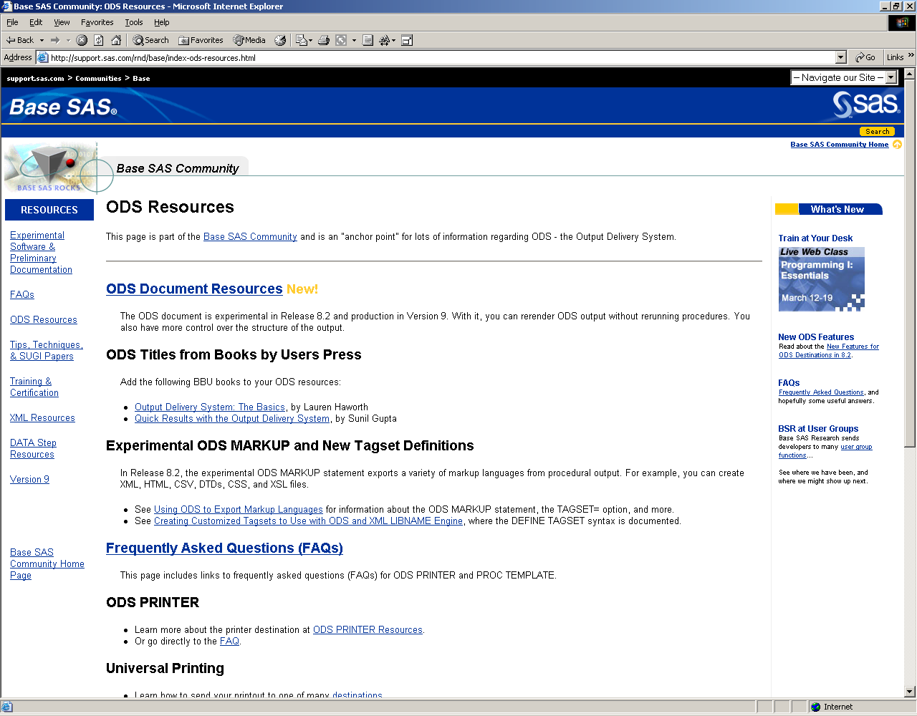
Useful ODS resources
http://www.sas.com/rnd/base/index-ods-resources.html
Essential to the serious ODS user
Covers much that is not yet documented

Slide 213
Exploit electronic services
Subscribe to SAS mailing lists:
  CHEST-SAS
  SAS-L
Search SAS-L archives via www.sas-l.com
Register & use E.M.I.T.S. for raising problems or questions to Tech Support
Search latest SAS notes via Email or using Web Interface
Access other SAS resources

Slide 214
SAS-L
International SAS User group on Internet
  Over 20,000 readers, many at SAS Institute
Nice interface at www.sas-l.com
To subscribe & receive emails, e.g.
  To: listserv@akh-wien.ac.at
  Message: subscribe sas-l Phil Mason
To read the newsgroup, look at:
  comp.soft-sys.sas

Slide 215
Participating in SAS-L
To post a message, e.g.
  To: sas-l@akh-wien.ac.at
  Subject: Problem with SAS/EIS
  Message: …
To search archives, send message below to listserv@akh-wien.ac.at
  //LOOKJFCB JOB DATABASE SEARCH DD=RULES
  //RULES DD *
  SEARCH DDE IN SAS-L SINCE 20-JUL-96
  INDEX # DATE.8 SENDER.30 SUBJECT.40
  PRINT 11720 12438 76347
http://www.listserv.uga.edu/archives/sas-l.html

Slide 216
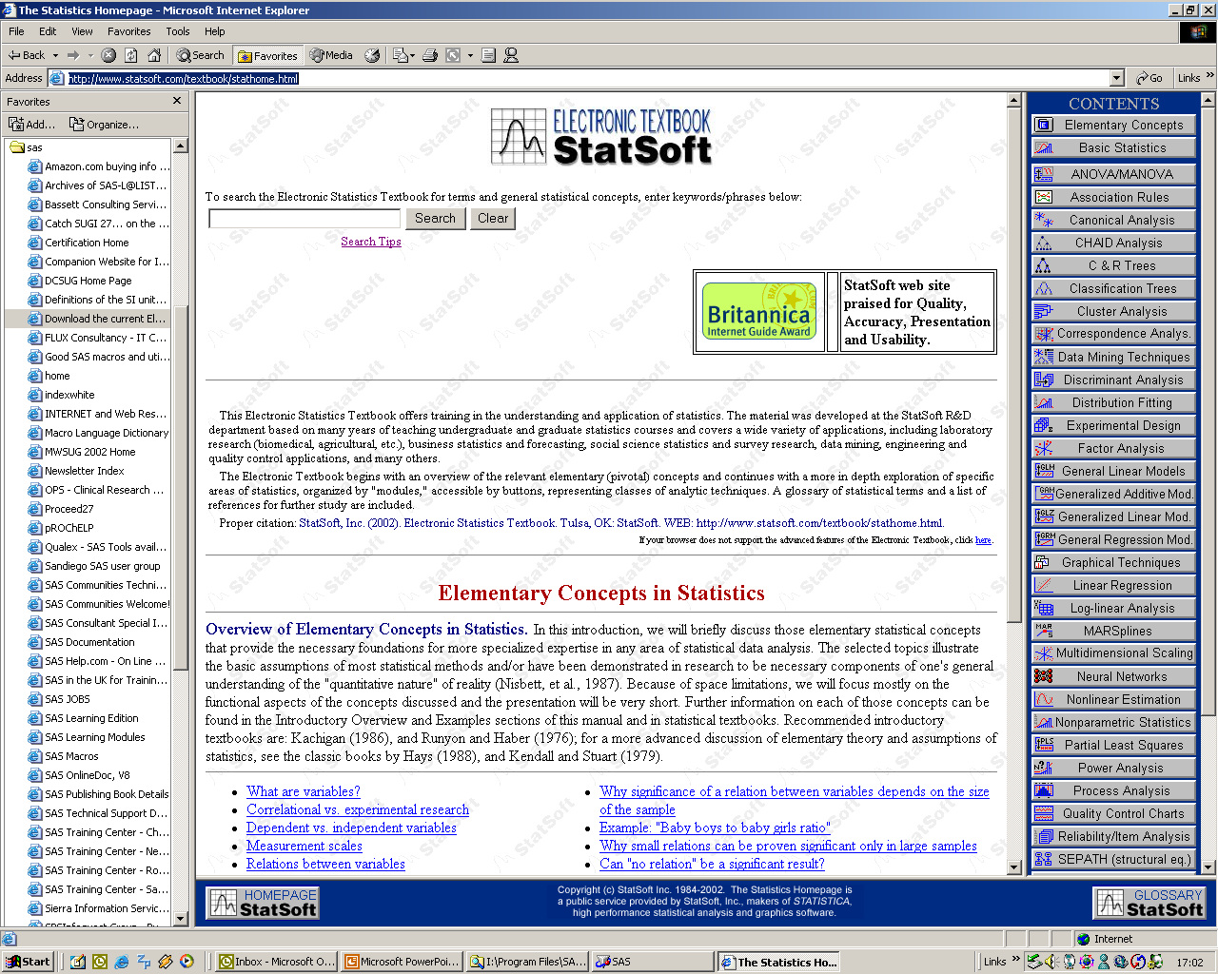
Electronic online textbook
http://www.statsoft.com/textbook/stathome.html

Slide 217


Get this book!
General Tips
  Assorted tips, managing resources
Data Step & macro Tips
Procedure Tips
  Format, Print, Stats, etc.
SAS/AF tips
  Frame & SCL

Slide 218
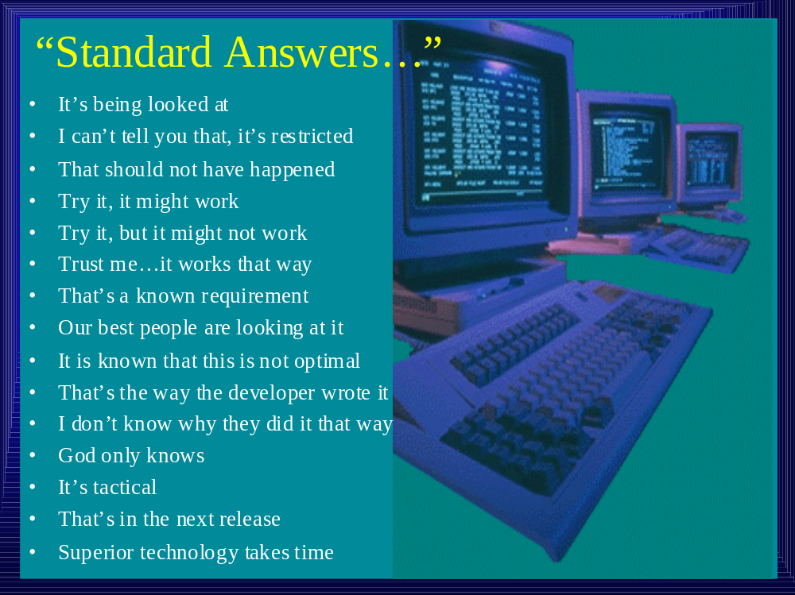
Standard Answers

Slide 219
Now for more tips
Tips from my SAS Tips & Techniques Newsletter
Subscribe at www.woodstreet.org.uk
You have some in your handouts…
  Now we will look through them

Slide 220
Export to excel via libname
Use excel engine
  Libname out excel ‘c:\test.xls’
Each dataset written to libref creates a new sheet

Slide 221
Using native excel formatting
Use style overrides in ODS to send extra formatting information
Use MSO directives to control formatting
  Microsoft Office XML

Slide 222
Creating CSV files from data step, easily
Use dsd and special put format
filename out 'c:\out.csv' ;
data _null_;
file out dsd;
set sashelp.class;
put (_all_) (:);
run;
filename out ;

Slide 223
Specifying character/numeric variable ranges
data _null_ ;
set sashelp.prdsale ;
put actual-numeric-month ; * numeric range ;
put country-character-product ; * character range ;
run ;

Slide 224
Producing a spreadsheet for each by group
ods listing close;
ods html path="c:\temp\"
body="html\body.xls"
contents="contents.html"
newfile=page;
proc sort data=sashelp.prdsale ;
by product ;
run ;
proc tabulate data=sashelp.prdsale ;
by product ;
class country region ;
var actual predict ;
table country all,
region all,
(actual predict)*sum ;
run ;
ods html close ;
dm "wbrowse 'c:\temp\contents.html'" wbrowse ;

Slide 225
Make the right sized activex for your resolution
* Define your preferred settings for various resolutions ;
%let qvga=xpixels=320 ypixels=240 ;
%let vga=xpixels=640 ypixels=480 ;
%let svga=xpixels=800 ypixels=600 ;
%let xga=xpixels=1024 ypixels=768 ;
* Select the resolution you want to use ;
%let resolution=vga;
ods html file='graph.htm' gpath='c:\' ;
* Choose the ACTIVEX driver with the appropriate resolution ;
goptions device=ActiveX &&&resolution ;
proc gchart data=sashelp.class ;
vbar3d age / subgroup=sex ;
run ;
ods html close ;

Slide 226
Plot details of slices in a Pie
ods html file='c:\test.html' gpath='c:\' ;
goptions reset=all device=png
xmax=20 ymax=12 /* make PNG bigger */
ftext='Arial' htext=4pct /* use some nice looking text */;
proc gchart;
pie region / angle=320
slice=outside
percent=inside
value=none
sumvar=Machinery
detail_percent=best
detail=country
descending ;
run; quit;
ods html close ;

Slide 227
Changing resolution of graphs
%macro testres(x,y,dpi) ;
* x ... number of inches across graphic ;
* y ... number of inches across graphic ;
* dpi ... resolution in dots per inch ;
filename out "c:\test&dpi..png" ;
goptions reset=all /* reset everything first */
dev=png /* driver to use */
xmax=&x in
ymax=&y in
xpixels=%sysevalf(&x*&dpi)
ypixels=%sysevalf(&y*&dpi)
ftext="SAS Monospace" /* choose a nice font */
htext=3 pct /* make font a good size */
gsfname=out /* where to save graphic */ ;

Slide 228
Getting your IP address and connecting to yourself
*** Part 1 ***;
filename cmd pipe 'ipconfig' ;
data _null_ ;
infile cmd dlm='.: ' ;
input @'IP Address' n1 n2 n3 n4 3. ;
IP_Address=compress(put(n1,3.)||'.' ||put(n2,3.)||'.'
||put(n3,3.)||'.' ||put(n4,3.));
call symput('ip',ip_address) ;
run ;
%put My IP address is &ip ;
*** Part 2 ***;
%let london=&ip;
/*%let london=homepc; * can alternatively use the PC name;*/
signon london ;
rsubmit london ;
proc setinit ; run ;
endrsubmit ;

Slide 229
Are your random numbers really random?
data case;
retain Seed_1 Seed_2 Seed_3 1 ;
do i=1 to 10;
call ranuni(Seed_1,X1) ; * call with unchanging seed ;
call ranuni(Seed_2,X2) ; * call with seed changing half way through ;
X3=ranuni(Seed_3) ; * function with seed changing half way through ;
output;
* change seed for last 5 rows ;
if i=5 then
do;
Seed_2=2;
Seed_3=2;
end;
end;
run;
proc print;
id i;
var Seed_1-Seed_3 X1-X3;
run;

Slide 230
Using pictures as patterns in bar charts
Can generate some images and then use them as the patterns for parts of a graph
pattern1 image='c:\sex11.png' ;
pattern2 image='c:\sex12.png' ;
pattern3 image='c:\sex13.png' ;
pattern4 image='c:\sex14.png' ;
pattern5 image='c:\sex15.png' ;
pattern6 image='c:\sex16.png' ;

Slide 231
Turning comments on and off
%let a=/; * comments active ;
%let b=*; * comments active ;
*** to deactivate set A & B to blanks ***;
&a&b
proc print data=x ;
run ;
*/;
data _null_ ;
run ;

Slide 232
Producing multi-column reports
%let dest=rtf; * pdf, ps or rtf ;
%let cols=2 ;
ods &dest columns=&cols file="c:\test.&dest" ;
goptions rotate=landscape ;
proc print data=sashelp.shoes ;
var region stores sales ;
run ;
ods &dest close ;

Slide 233
Automatic checking of log
Write log to catalog member
filename cat catalog 'work.test.test.log' ;
dm 'log;file cat' ; * write log to catalog member ;
Then process and display message if error
window status rows=15 columns=40 color=gray
#5 'No errors or warnings were found.' color=yellow
#9 'Press enter to continue' ;
display status ;

Slide 234
Finding and using available ODS styles
proc template ;
list styles ;
run ;

Slide 235
Using a web browser to view HTML ODS output
Two ways
First – change preference to use external web browser
Second – use wbrowse display manager command
dm "wbrowse 'c:\frame.html'" ;

Slide 236
Choosing orientation of RTF output
ods rtf file = 'c:\test.rtf';
* This will be in Portrait orientation since that is the default ;
proc print data = sashelp.class;
run;
options orientation = landscape;
* The option has changed, but now we need to tell RTF that it changed ;
ods rtf;
* Now this will be in landscape ;
proc print data = sashelp.class;
run;
ods rtf close;

Slide 237
Generating graphs automatically for some procedures
ods listing close ;
ods html file='lifetest.html' style=mystyle;
ods graphics on;
proc lifetest data=sasuser.fitness;
time age;
survival confband=all plots=(hwb);
run;
ods graphics off;
ods html close;

Slide 238
Starting and minimising programs from SAS
* don’t wait for command to finish or synchronize with rest of SAS ;
options noxwait noxsync ;
* start MS Word and minimize it ;
x "start /min C:\Progra~1\Micros~3\Office10\winword.exe" ;
* You can specify the real path to the file, provided you enclose the long file names in double quotes, and enclose the whole thing in single quotes. The code below works ;
x '"C:\Program Files\Microsoft Office\Office10\winword.exe"' ;

Slide 239
Using Java and activex to generate static graphs
goptions device=actximg ;
/*goptions device=javaimg ;*/
ods html body='c:\test.html'
gpath='c:\'
(url=none) ;
proc gchart data=sashelp.shoes ;
vbar3d product / sumvar=sales ;
run ;
ods html close ;

Slide 240
Page x of y in RTF & PDF
Sample code for RTF
ods escapechar = '\';
title 'This document will have page x of y '
j=r 'Page \{pageof}' ;
ods rtf file='c:\test.rtf' ;
proc print data=sashelp.prdsale;
run;
ods rtf close;
Sample code for PDF
ods escapechar = '\';
title 'This document will have page x of y '
j=r 'Page \{thispage} of \{lastpage}' ;
ods pdf file='c:\test.pdf' ;
proc print data=sashelp.prdsale;
run;
ods pdf close;

Slide 241
Page x of y in RTF (SAS 8)
ODS ESCAPECHAR="^";
footnote J=R "^R/RTF'{PAGE \field {\*\fldinst PAGE\*\MERGEFORMAT}} { OF \field {\*\fldinst NUMPAGES \*\MERGEFORMAT} }'";

Slide 242
Get list of paper sizes
proc registry list startat="CORE\PRINTING\PAPER SIZES";
run;
* We can set the paper size to a pre-defined size, or enter measurements ;
options papersize=a3;
* Now we produce output and can verify in MS Word
that the page size is A3 as selected ;
ods rtf file='c:\test.rtf' ;
proc print data=sashelp.prdsale;
run ;
ods rtf close ;

Slide 243
Automatically document your programs
Scans a directory and looks at all SAS code
  strips out the comments
  creates an MS Word file for documentation
If you follow a standard and always have key documentation in headers, then this works well

Slide 244
Run SAS easily in batch on windows
Open windows explorer
Go into file associations for “.sas”
Set action to run program in batch
  Can modify command used to invoke it

Slide 245
Change Control: Developing code in a client/server environment (Windows & UNIX)
Macro | value on windows XP | value on UNIX Solaris
&sysscp | Win | SUN 4
&sysscpl | Win_pro | SunOS
&sysver | 8.2 | 8.2
&sysvlong | 8.02.02M0P012301 | 8.02.02M0P012301

Slide 246
Generation datasets
* keep multiple copies of data sets ;
data x(genmax=5) ; a=1 ; run ;
* each time we create the dataset again it makes another generation ;
data x ; a=2 ; run ;
data x ; a=3 ; run ;
data x ; a=4 ; run ;
* current generation is 0, or just dont specify the one you want ;
data y ; set x(gennum=0) ; put a= ; run ;
* generation 2 is the 2nd one created - actually called x#002 ;
data y ; set x(gennum=2) ; put a= ; run ;
* generation -1 is the previous one created, not the current one bu the one before ;
data y ; set x(gennum=-1) ; put a= ; run ;

Slide 247
Getting the date, time & size of a non-SAS file
Run directory listing and read from pipe
filename cmd pipe "&dir_cmd" ;
Parse what is read
  Will vary between operating systems
    Or versions of operating systems may vary too

Slide 248
Adding a progress “bar” to a data step
%macro progress(every) ;
window progress irow=4 rows=7 columns=40
#1 @6 'Processing record: ' _n_ persist=yes ;
if mod(_n_,&every)=0 then
display progress noinput ;
%mend progress ;
How to use it
All you need to do is to add the macro call to your data step. The following data step updates the record count every 1000 records read in.
data x ;
infile 'm:\datasets\x.txt' ;
input name $30. phone $18. ;
%progress(1000) ;
run ;

Slide 249
Viewing Tables with variable names, not labels
Click on sas explorer
Tools, options, explorer
Members tab
Select TABLE
Click edit
Select &open
Click edit
Add colheading=name to viewtable command

Slide 250
Finding help from SAS help files (Viewtable)
Highlight a word in SAS editor and press F1
Sometimes can find things documented here that are not elsewhere
  E.g. viewtable command options

Slide 251
Running SAS 8.2 code from SAS 9
options noxwait noxsync ;
x '"C:\Program Files\SAS Institute\SAS\V8\spawner.exe" -comamid tcp' ;
signon jvc;
rsubmit ;
%put REMOTE: &sysver;
endrsubmit ;
%put LOCAL: &sysver;
signoff ;

Slide 252
Some basics of creating XML in SAS 9
libname test xml 'c:\test.xml' ;
data test.sample ;
name='Phil Mason' ;
age=40 ;
sex='M' ;
phone='01491 824905' ;
country='England' ;
run ;
libname test ;

Slide 253
Using SAS 8.2 from SAS 9 in an IOM architecture
A bit complicated to explain

Slide 254
Reading more complex XML files
Explain
A bit complex to explain code now

Slide 255

Thanks for coming
The End!

